Slide 1
Leicester RC Circuits

Slide 2
Warm Up
5 Minutes

Slide 3
Get Ready
5
4
3
2
1

Slide 4
Squat Jump (30 Sec)

Slide 5
Change to Burpee

Slide 6
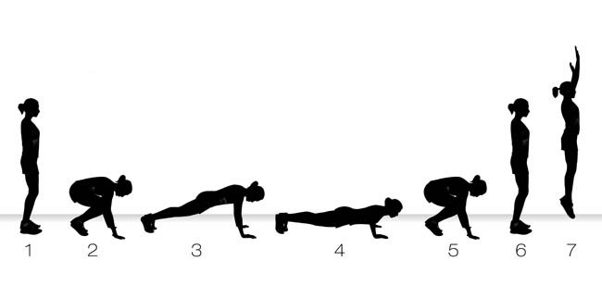
Burpee (30 Sec)

Slide 7
Change to Mountain Climbers

Slide 8
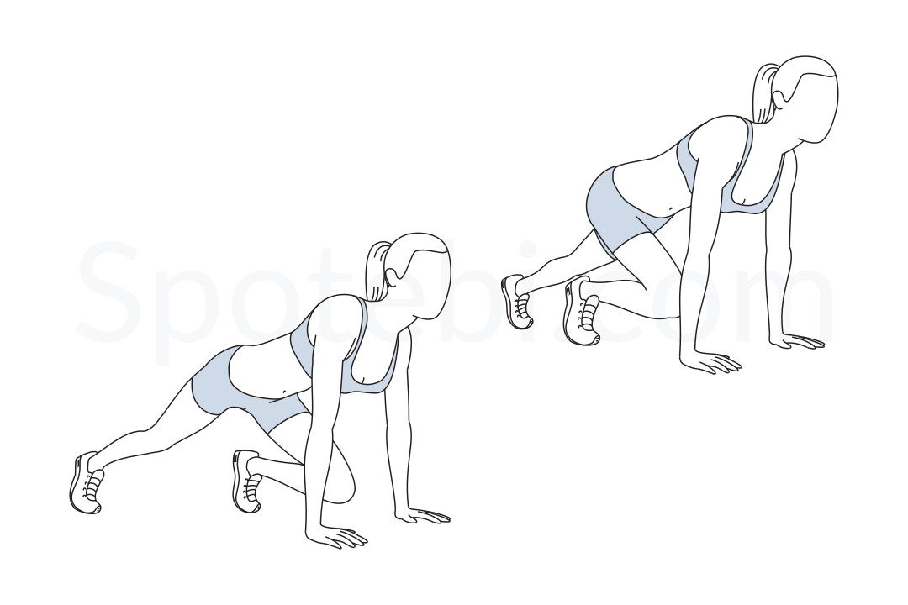
Mountain Climbers (30 Sec)

Slide 9
Change to Tricep Dip

Slide 10
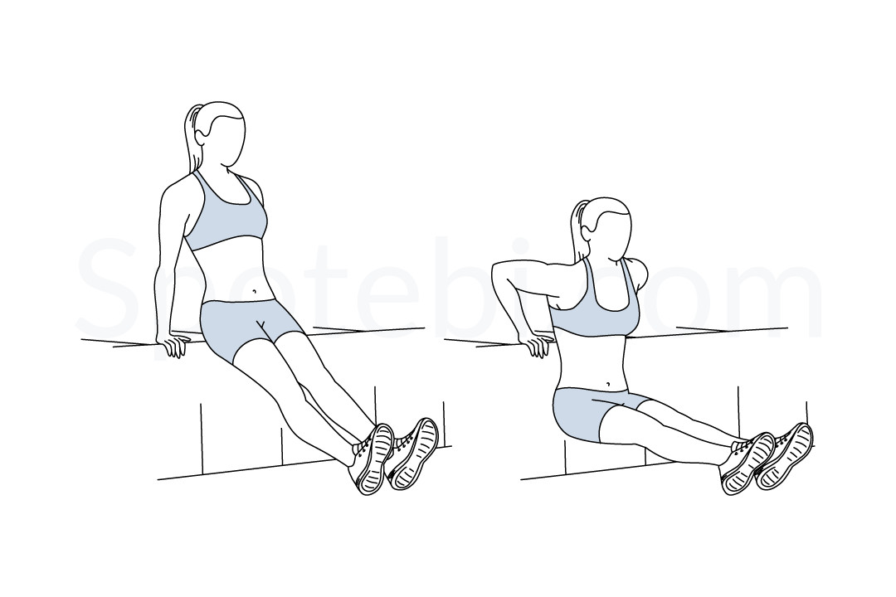
Tricep Dip (30 Sec)

Slide 11
Change to Lunges

Slide 12
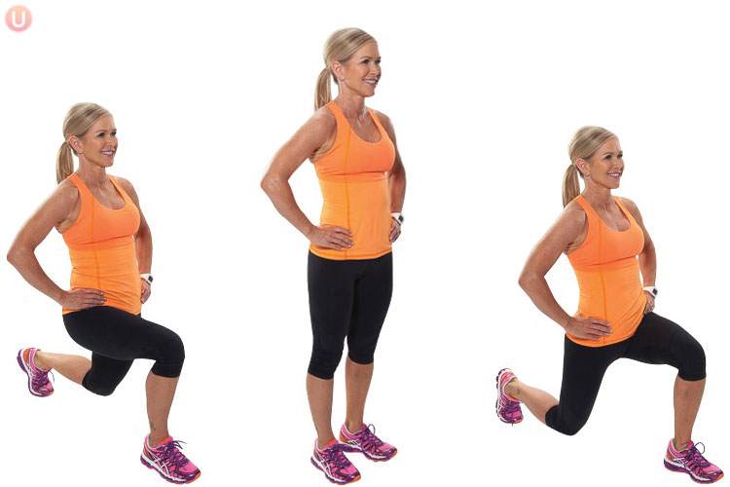
Lunge (30 Sec)

Slide 13
Change to Squat

Slide 14
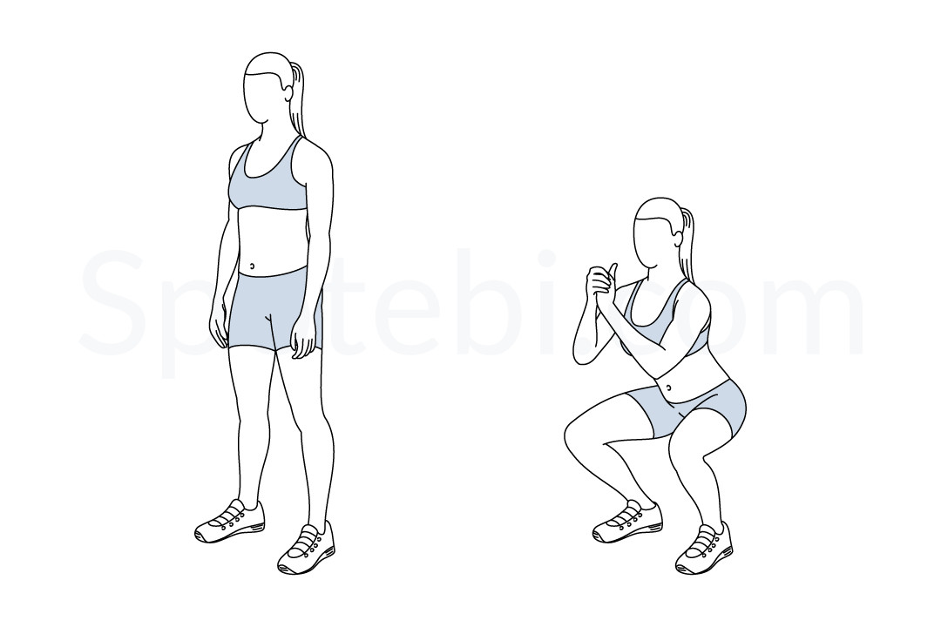
Squat (30 Sec)

Slide 15
Change to Squat Jump

Slide 16
Squat Jump (30 Sec)

Slide 17
Change to Burpee

Slide 18
Burpee (30 Sec)

Slide 19
Change to Mountain Climbers

Slide 20
Mountain Climbers (30 Sec)

Slide 21
Change to Tricep Dip

Slide 22
Tricep Dip (30 Sec)

Slide 23
Change to Lunges

Slide 24
Lunge (30 Sec)

Slide 25
Change to Squat

Slide 26
Squat (30 Sec)

Slide 27
Change to Squat Jump

Slide 28
Squat Jump (30 Sec)

Slide 29
Change to Burpee

Slide 30
Burpee (30 Sec)

Slide 31
Change to Mountain Climbers

Slide 32
Mountain Climbers (30 Sec)

Slide 33
Change to Tricep Dip

Slide 34
Tricep Dip (30 Sec)

Slide 35
Change to Lunges

Slide 36
Lunge (30 Sec)

Slide 37
Change to Squat

Slide 38
Squat (30 Sec)

Slide 39
Change to Squat Jump

Slide 40
Squat Jump (30 Sec)

Slide 41
Change to Burpee

Slide 42
Burpee (30 Sec)

Slide 43
Change to Mountain Climbers

Slide 44
Mountain Climbers (30 Sec)

Slide 45
Change to Tricep Dip

Slide 46
Tricep Dip (30 Sec)

Slide 47
Change to Lunges

Slide 48
Lunge (30 Sec)

Slide 49
Change to Squat

Slide 50
Squat (30 Sec)

Slide 51
Change to Squat Jump

Slide 52
Squat Jump (30 Sec)

Slide 53
Change to Burpee

Slide 54
Burpee (30 Sec)

Slide 55
Change to Mountain Climbers

Slide 56
Mountain Climbers (30 Sec)

Slide 57
Change to Tricep Dip

Slide 58
Tricep Dip (30 Sec)

Slide 59
Change to Lunges

Slide 60
Lunge (30 Sec)

Slide 61
Change to Squat

Slide 62
Squat (30 Sec)

Slide 63
1 Min 30 Sec Rest

Slide 64
Change to Squat Jump

Slide 65
Squat Jump (30 Sec)

Slide 66
Change to Burpee

Slide 67
Burpee (30 Sec)

Slide 68
Change to Mountain Climbers

Slide 69
Mountain Climbers (30 Sec)

Slide 70
Change to Tricep Dip

Slide 71
Tricep Dip (30 Sec)

Slide 72
Change to Lunges

Slide 73
Lunge (30 Sec)

Slide 74
Change to Squat

Slide 75
Squat (30 Sec)

Slide 76
Change to Squat Jump

Slide 77
Squat Jump (30 Sec)

Slide 78
Change to Burpee

Slide 79
Burpee (30 Sec)

Slide 80
Change to Mountain Climbers

Slide 81
Mountain Climbers (30 Sec)

Slide 82
Change to Tricep Dip

Slide 83
Tricep Dip (30 Sec)

Slide 84
Change to Lunges

Slide 85
Lunge (30 Sec)

Slide 86
Change to Squat

Slide 87
Squat (30 Sec)

Slide 88
Change to Squat Jump

Slide 89
Squat Jump (30 Sec)

Slide 90
Change to Burpee

Slide 91
Burpee (30 Sec)

Slide 92
Change to Mountain Climbers

Slide 93
Mountain Climbers (30 Sec)

Slide 94
Change to Tricep Dip

Slide 95
Tricep Dip (30 Sec)

Slide 96
Change to Lunges

Slide 97
Lunge (30 Sec)

Slide 98
Change to Squat

Slide 99
Squat (30 Sec)

Slide 100
Change to Squat Jump

Slide 101
Squat Jump (30 Sec)

Slide 102
Change to Burpee

Slide 103
Burpee (30 Sec)

Slide 104
Change to Mountain Climbers

Slide 105
Mountain Climbers (30 Sec)

Slide 106
Change to Tricep Dip

Slide 107
Tricep Dip (30 Sec)

Slide 108
Change to Lunges

Slide 109
Lunge (30 Sec)

Slide 110
Change to Squat

Slide 111
Squat (30 Sec)

Slide 112
Change to Squat Jump

Slide 113
Squat Jump (30 Sec)

Slide 114
Change to Burpee

Slide 115
Burpee (30 Sec)

Slide 116
Change to Mountain Climbers

Slide 117
Mountain Climbers (30 Sec)

Slide 118
Change to Tricep Dip

Slide 119
Tricep Dip (30 Sec)

Slide 120
Change to Lunges

Slide 121
Lunge (30 Sec)

Slide 122
Change to Squat

Slide 123
Squat (30 Sec)

Slide 124
Change to Squat Jump

Slide 125
8 minute core

