Slide 1
Leicester RC Circuits

Slide 2
Warm Up
5 Minutes

Slide 3
Get Ready
5
4
3
2
1

Slide 4
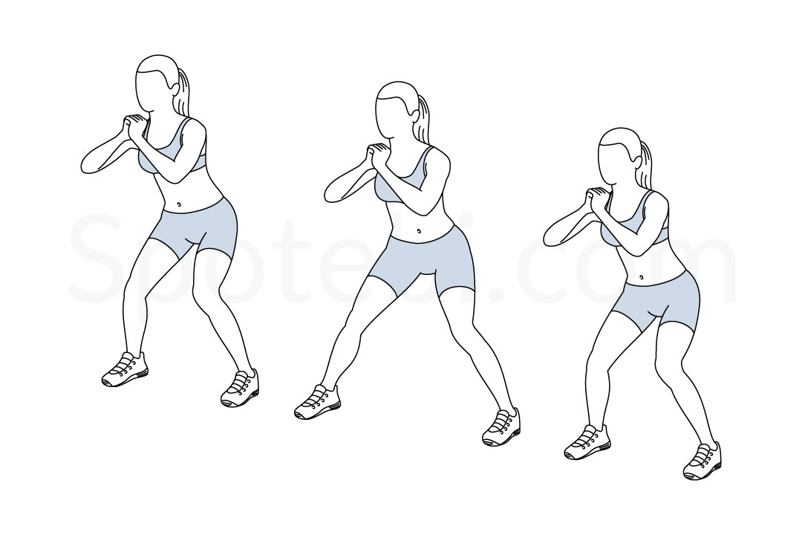
Side Squat (30 Sec)

Slide 5
Change to Burpee

Slide 6
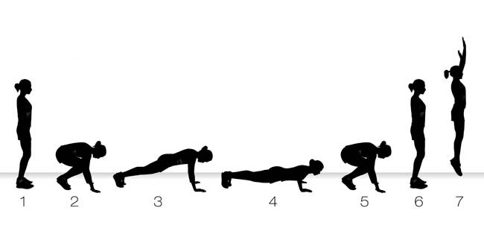
Burpee (30 Sec)

Slide 7
Change to Press Up

Slide 8
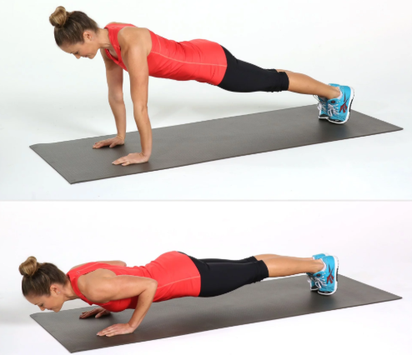
Press Up (30 Sec)

Slide 9
Change to Lunge with Knee Drive – Left Leg

Slide 10
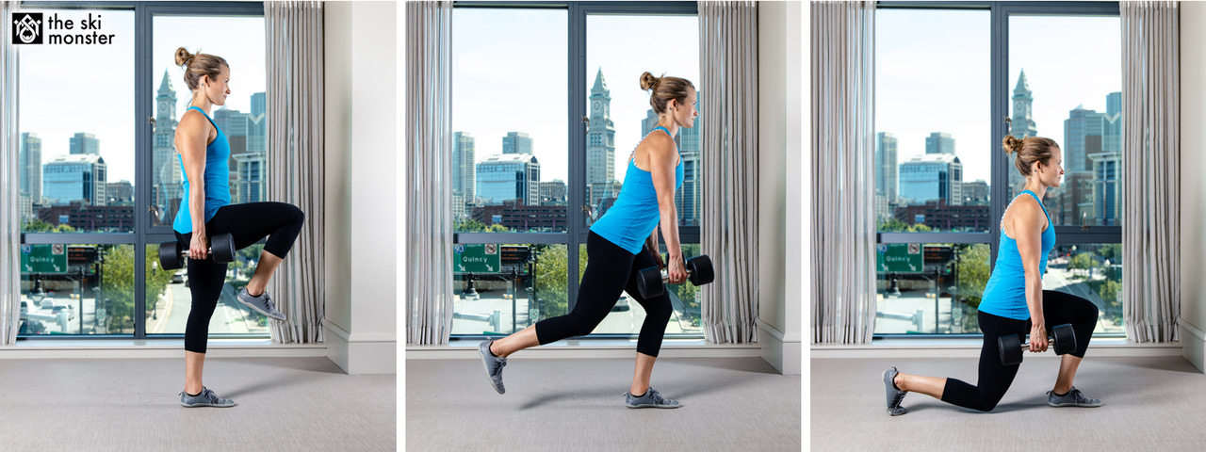
Lunge with Knee Drive – Left Leg (15 Sec)

Slide 11
Change to Lunge with Knee Drive – Right Leg

Slide 12
Lunge with Knee Drive – Right Leg (15 Sec)

Slide 13
Change to Mountain Climbers

Slide 14
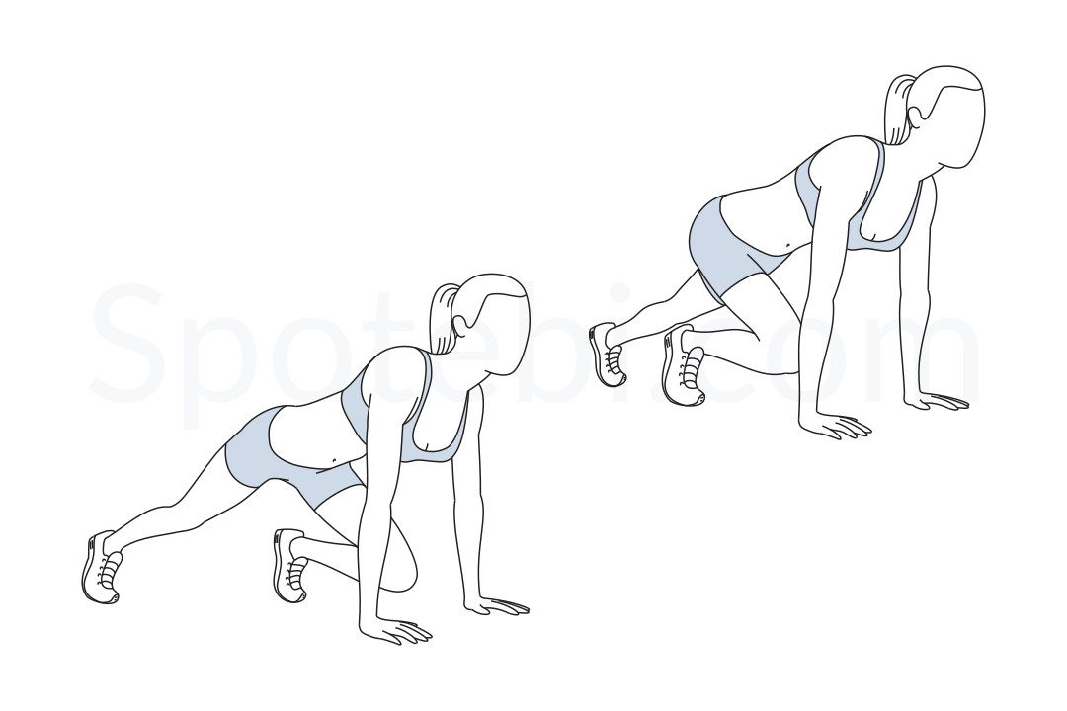
Mountain Climbers (30 Sec)

Slide 15
Change to High Knees

Slide 16
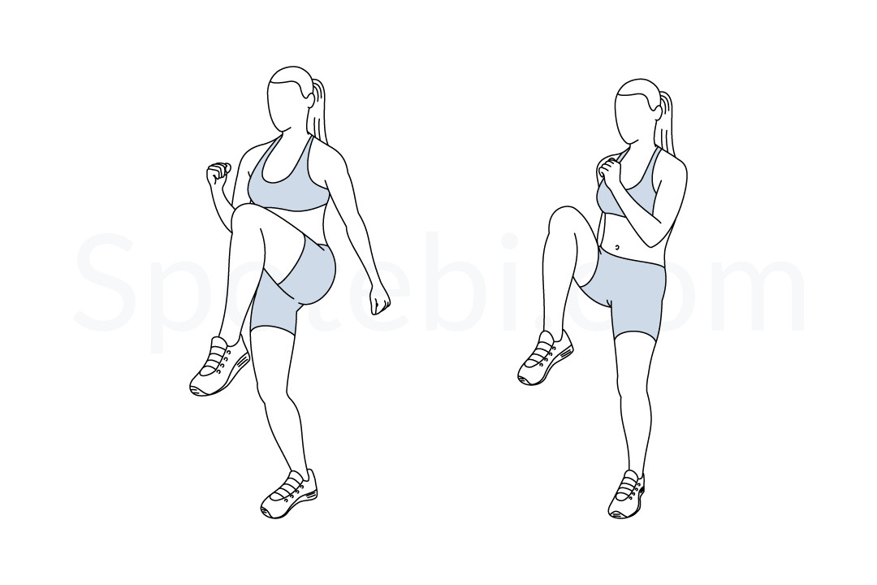
High Knees (30 Sec)

Slide 17
Change to Side Squat

Slide 18
Side Squat (30 Sec)

Slide 19
Change to Burpee

Slide 20
Burpee (30 Sec)

Slide 21
Change to Press Up

Slide 22
Press Up (30 Sec)

Slide 23
Change to Lunge with Knee Drive – Left Leg

Slide 24
Lunge with Knee Drive – Left Leg (15 Sec)

Slide 25
Change to Lunge with Knee Drive – Right Leg

Slide 26
Lunge with Knee Drive – Right Leg (15 Sec)

Slide 27
Change to Mountain Climbers

Slide 28
Mountain Climbers (30 Sec)

Slide 29
Change to High Knees

Slide 30
High Knees (30 Sec)

Slide 31
Change to Side Squat

Slide 32
Side Squat (30 Sec)

Slide 33
Change to Burpee

Slide 34
Burpee (30 Sec)

Slide 35
Change to Press Up

Slide 36
Press Up (30 Sec)

Slide 37
Change to Lunge with Knee Drive – Left Leg

Slide 38
Lunge with Knee Drive – Left Leg (15 Sec)

Slide 39
Change to Lunge with Knee Drive – Right Leg

Slide 40
Lunge with Knee Drive – Right Leg (15 Sec)

Slide 41
Change to Mountain Climbers

Slide 42
Mountain Climbers (30 Sec)

Slide 43
Change to High Knees

Slide 44
High Knees (30 Sec)

Slide 45
Change to Side Squat

Slide 46
Side Squat (30 Sec)

Slide 47
Change to Burpee

Slide 48
Burpee (30 Sec)

Slide 49
Change to Press Up

Slide 50
Press Up (30 Sec)

Slide 51
Change to Lunge with Knee Drive – Left Leg

Slide 52
Lunge with Knee Drive – Left Leg (15 Sec)

Slide 53
Change to Lunge with Knee Drive – Right Leg

Slide 54
Lunge with Knee Drive – Right Leg (15 Sec)

Slide 55
Change to Mountain Climbers

Slide 56
Mountain Climbers (30 Sec)

Slide 57
Change to High Knees

Slide 58
High Knees (30 Sec)

Slide 59
Change to Side Squat

Slide 60
Side Squat (30 Sec)

Slide 61
Change to Burpee

Slide 62
Burpee (30 Sec)

Slide 63
Change to Press Up

Slide 64
Press Up (30 Sec)

Slide 65
Change to Lunge with Knee Drive – Left Leg

Slide 66
Lunge with Knee Drive – Left Leg (15 Sec)

Slide 67
Change to Lunge with Knee Drive – Right Leg

Slide 68
Lunge with Knee Drive – Right Leg (15 Sec)

Slide 69
Change to Mountain Climbers

Slide 70
Mountain Climbers (30 Sec)

Slide 71
Change to High Knees

Slide 72
High Knees (30 Sec)

Slide 73
1 Min 30 Sec Rest

Slide 74
Side Squat (30 Sec)

Slide 75
Change to Burpee

Slide 76
Burpee (30 Sec)

Slide 77
Change to Press Up

Slide 78
Press Up (30 Sec)

Slide 79
Change to Lunge with Knee Drive – Left Leg

Slide 80
Lunge with Knee Drive – Left Leg (15 Sec)

Slide 81
Change to Lunge with Knee Drive – Right Leg

Slide 82
Lunge with Knee Drive – Right Leg (15 Sec)

Slide 83
Change to Mountain Climbers

Slide 84
Mountain Climbers (30 Sec)

Slide 85
Change to High Knees

Slide 86
High Knees (30 Sec)

Slide 87
Change to Side Squat

Slide 88
Side Squat (30 Sec)

Slide 89
Change to Burpee

Slide 90
Burpee (30 Sec)

Slide 91
Change to Press Up

Slide 92
Press Up (30 Sec)

Slide 93
Change to Lunge with Knee Drive – Left Leg

Slide 94
Lunge with Knee Drive – Left Leg (15 Sec)

Slide 95
Change to Lunge with Knee Drive – Right Leg

Slide 96
Lunge with Knee Drive – Right Leg (15 Sec)

Slide 97
Change to Mountain Climbers

Slide 98
Mountain Climbers (30 Sec)

Slide 99
Change to High Knees

Slide 100
High Knees (30 Sec)

Slide 101
Change to Side Squat

Slide 102
Side Squat (30 Sec)

Slide 103
Change to Burpee

Slide 104
Burpee (30 Sec)

Slide 105
Change to Press Up

Slide 106
Press Up (30 Sec)

Slide 107
Change to Lunge with Knee Drive – Left Leg

Slide 108
Lunge with Knee Drive – Left Leg (15 Sec)

Slide 109
Change to Lunge with Knee Drive – Right Leg

Slide 110
Lunge with Knee Drive – Right Leg (15 Sec)

Slide 111
Change to Mountain Climbers

Slide 112
Mountain Climbers (30 Sec)

Slide 113
Change to High Knees

Slide 114
High Knees (30 Sec)

Slide 115
Change to Side Squat

Slide 116
Side Squat (30 Sec)

Slide 117
Change to Burpee

Slide 118
Burpee (30 Sec)

Slide 119
Change to Press Up

Slide 120
Press Up (30 Sec)

Slide 121
Change to Lunge with Knee Drive – Left Leg

Slide 122
Lunge with Knee Drive – Left Leg (15 Sec)

Slide 123
Change to Lunge with Knee Drive – Right Leg

Slide 124
Lunge with Knee Drive – Right Leg (15 Sec)

Slide 125
Change to Mountain Climbers

Slide 126
Mountain Climbers (30 Sec)

Slide 127
Change to High Knees

Slide 128
High Knees (30 Sec)

Slide 129
Change to Side Squat

Slide 130
Side Squat (30 Sec)

Slide 131
Change to Burpee

Slide 132
Burpee (30 Sec)

Slide 133
Change to Press Up

Slide 134
Press Up (30 Sec)

Slide 135
Change to Lunge with Knee Drive – Left Leg

Slide 136
Lunge with Knee Drive – Left Leg (15 Sec)

Slide 137
Change to Lunge with Knee Drive – Right Leg

Slide 138
Lunge with Knee Drive – Right Leg (15 Sec)

Slide 139
Change to Mountain Climbers

Slide 140
Mountain Climbers (30 Sec)

Slide 141
Change to High Knees

Slide 142
High Knees (30 Sec)

Slide 143
8 minute core

