Slide 1
Leicester RC Circuits

Slide 2
Warm Up
5 Minutes

Slide 3
Get Ready
5
4
3
2
1

Slide 4
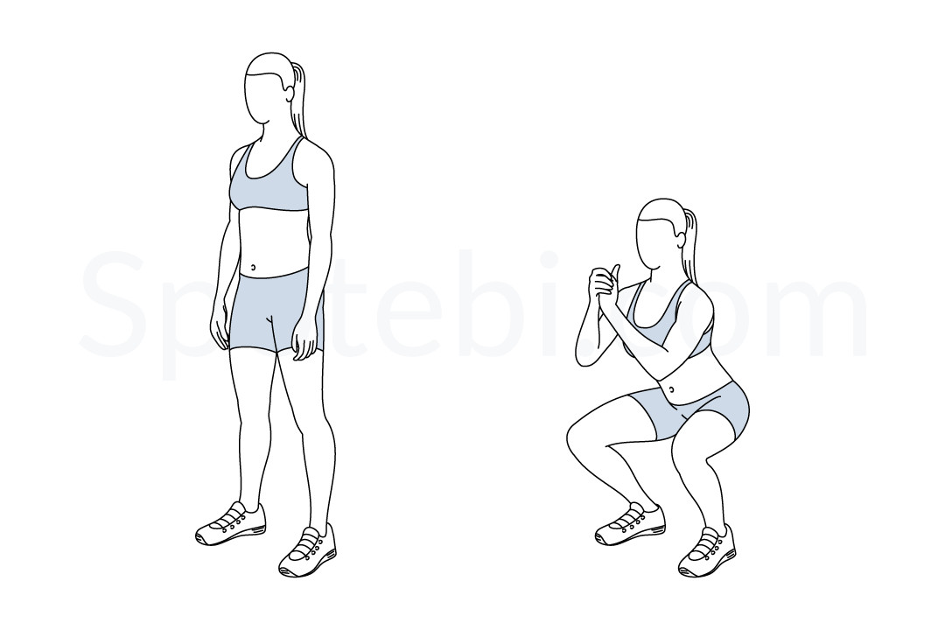
Squat (30 Sec)

Slide 5
Change to Press Up

Slide 6
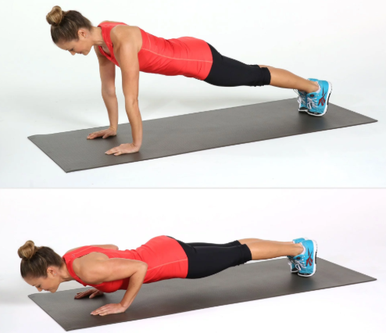
Press Up (30 Sec)

Slide 7
Change to Star Jumps

Slide 8
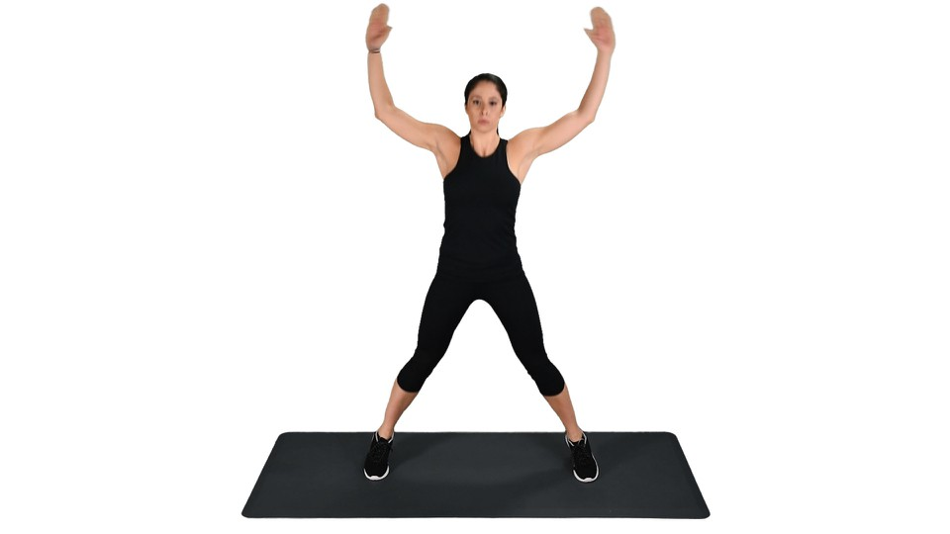
Star Jumps (30 Sec)

Slide 9
Change to Lunges

Slide 10
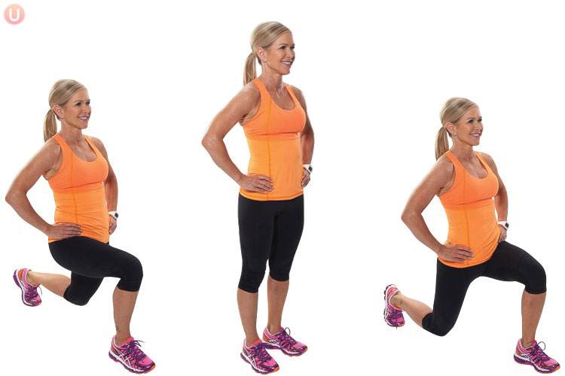
Lunge (30 Sec)

Slide 11
Change to Tricep Dip

Slide 12
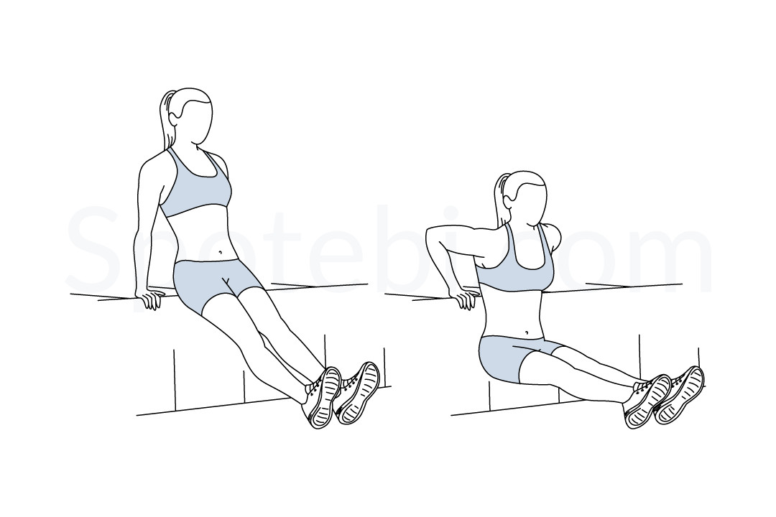
Tricep Dip (30 Sec)

Slide 13
Change to Donkey Kicks, Left Leg

Slide 14
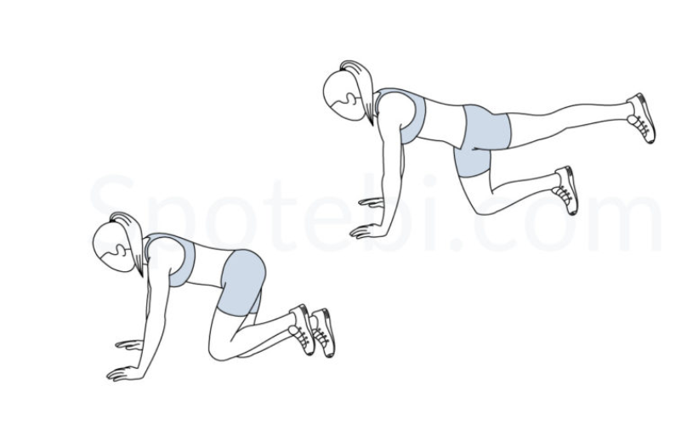
Donkey Kicks Left Leg (15 Sec)

Slide 15
Change to Donkey Kicks, Right Leg

Slide 16
Donkey Kicks Right Leg (15 Sec)

Slide 17
Change to Squat

Slide 18
Squat (30 Sec)

Slide 19
Change to Press Up

Slide 20
Press Up (30 Sec)

Slide 21
Change to Star Jumps

Slide 22
Star Jumps (30 Sec)

Slide 23
Change to Lunges

Slide 24
Lunge (30 Sec)

Slide 25
Change to Tricep Dip

Slide 26
Tricep Dip (30 Sec)

Slide 27
Change to Donkey Kicks, Left Leg

Slide 28
Donkey Kicks Left Leg (15 Sec)

Slide 29
Change to Donkey Kicks, Right Leg

Slide 30
Donkey Kicks Right Leg (15 Sec)

Slide 31
Change to Squat

Slide 32
Squat (30 Sec)

Slide 33
Change to Press Up

Slide 34
Press Up (30 Sec)

Slide 35
Change to Star Jumps

Slide 36
Star Jumps (30 Sec)

Slide 37
Change to Lunges

Slide 38
Lunge (30 Sec)

Slide 39
Change to Tricep Dip

Slide 40
Tricep Dip (30 Sec)

Slide 41
Change to Donkey Kicks, Left Leg

Slide 42
Donkey Kicks Left Leg (15 Sec)

Slide 43
Change to Donkey Kicks, Right Leg

Slide 44
Donkey Kicks Right Leg (15 Sec)

Slide 45
Change to Squat

Slide 46
Squat (30 Sec)

Slide 47
Change to Press Up

Slide 48
Press Up (30 Sec)

Slide 49
Change to Star Jumps

Slide 50
Star Jumps (30 Sec)

Slide 51
Change to Lunges

Slide 52
Lunge (30 Sec)

Slide 53
Change to Tricep Dip

Slide 54
Tricep Dip (30 Sec)

Slide 55
Change to Donkey Kicks, Left Leg

Slide 56
Donkey Kicks Left Leg (15 Sec)

Slide 57
Change to Donkey Kicks, Right Leg

Slide 58
Donkey Kicks Right Leg (15 Sec)

Slide 59
Change to Squat

Slide 60
Squat (30 Sec)

Slide 61
Change to Press Up

Slide 62
Press Up (30 Sec)

Slide 63
Change to Star Jumps

Slide 64
Star Jumps (30 Sec)

Slide 65
Change to Lunges

Slide 66
Lunge (30 Sec)

Slide 67
Change to Tricep Dip

Slide 68
Tricep Dip (30 Sec)

Slide 69
Change to Donkey Kicks, Left Leg

Slide 70
Donkey Kicks Left Leg (15 Sec)

Slide 71
Change to Donkey Kicks, Right Leg

Slide 72
Donkey Kicks Right Leg (15 Sec)

Slide 73
1 Min 30 Sec Rest

Slide 74
Squat (30 Sec)

Slide 75
Change to Press Up

Slide 76
Press Up (30 Sec)

Slide 77
Change to Star Jumps

Slide 78
Star Jumps (30 Sec)

Slide 79
Change to Lunges

Slide 80
Lunge (30 Sec)

Slide 81
Change to Tricep Dip

Slide 82
Tricep Dip (30 Sec)

Slide 83
Change to Donkey Kicks, Left Leg

Slide 84
Donkey Kicks Left Leg (15 Sec)

Slide 85
Change to Donkey Kicks, Right Leg

Slide 86
Donkey Kicks Right Leg (15 Sec)

Slide 87
Change to Squat

Slide 88
Squat (30 Sec)

Slide 89
Change to Press Up

Slide 90
Press Up (30 Sec)

Slide 91
Change to Star Jumps

Slide 92
Star Jumps (30 Sec)

Slide 93
Change to Lunges

Slide 94
Lunge (30 Sec)

Slide 95
Change to Tricep Dip

Slide 96
Tricep Dip (30 Sec)

Slide 97
Change to Donkey Kicks, Left Leg

Slide 98
Donkey Kicks Left Leg (15 Sec)

Slide 99
Change to Donkey Kicks, Right Leg

Slide 100
Donkey Kicks Right Leg (15 Sec)

Slide 101
Change to Squat

Slide 102
Squat (30 Sec)

Slide 103
Change to Press Up

Slide 104
Press Up (30 Sec)

Slide 105
Change to Star Jumps

Slide 106
Star Jumps (30 Sec)

Slide 107
Change to Lunges

Slide 108
Lunge (30 Sec)

Slide 109
Change to Tricep Dip

Slide 110
Tricep Dip (30 Sec)

Slide 111
Change to Donkey Kicks, Left Leg

Slide 112
Donkey Kicks Left Leg (15 Sec)

Slide 113
Change to Donkey Kicks, Right Leg

Slide 114
Donkey Kicks Right Leg (15 Sec)

Slide 115
Change to Squat

Slide 116
Squat (30 Sec)

Slide 117
Change to Press Up

Slide 118
Press Up (30 Sec)

Slide 119
Change to Star Jumps

Slide 120
Star Jumps (30 Sec)

Slide 121
Change to Lunges

Slide 122
Lunge (30 Sec)

Slide 123
Change to Tricep Dip

Slide 124
Tricep Dip (30 Sec)

Slide 125
Change to Donkey Kicks, Left Leg

Slide 126
Donkey Kicks Left Leg (15 Sec)

Slide 127
Change to Donkey Kicks, Right Leg

Slide 128
Donkey Kicks Right Leg (15 Sec)

Slide 129
Change to Squat

Slide 130
Squat (30 Sec)

Slide 131
Change to Press Up

Slide 132
Press Up (30 Sec)

Slide 133
Change to Star Jumps

Slide 134
Star Jumps (30 Sec)

Slide 135
Change to Lunges

Slide 136
Lunge (30 Sec)

Slide 137
Change to Tricep Dip

Slide 138
Tricep Dip (30 Sec)

Slide 139
Change to Donkey Kicks, Left Leg

Slide 140
Donkey Kicks Left Leg (15 Sec)

Slide 141
Change to Donkey Kicks, Right Leg

Slide 142
Donkey Kicks Right Leg (15 Sec)

Slide 143
8 minute core

