Slide 1
Leicester RC Circuits

Slide 2
Warm Up
5 Minutes

Slide 3
Get Ready
5
4
3
2
1

Slide 4
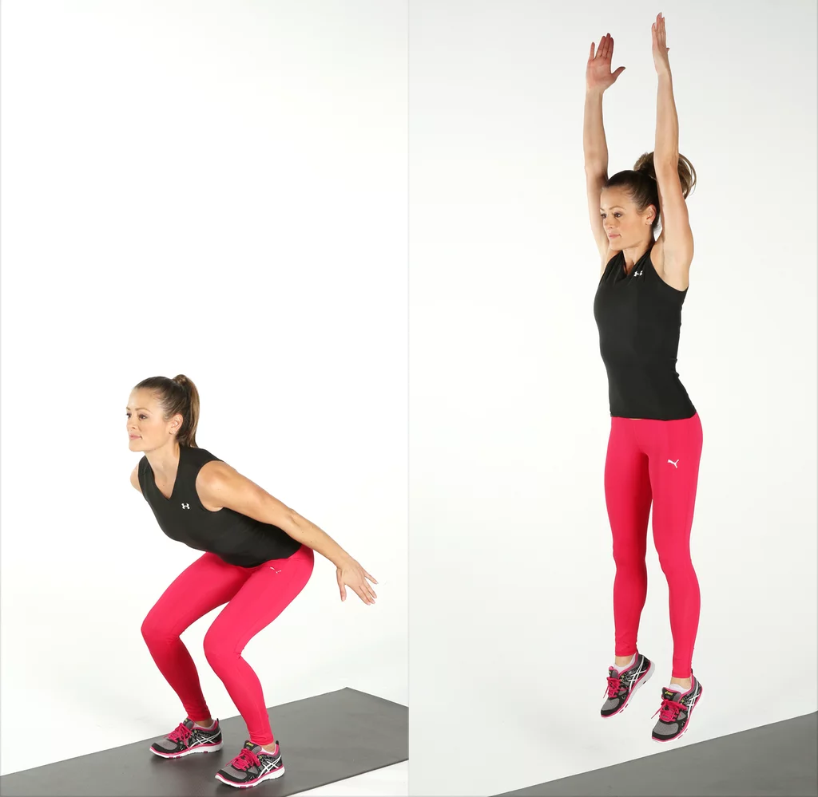
Squat Jump (30 Sec)

Slide 5
Change to Sit Up

Slide 6
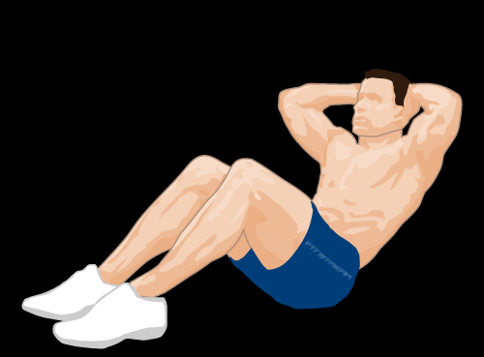
Sit Up (30 Sec)

Slide 7
Change to Burpee

Slide 8
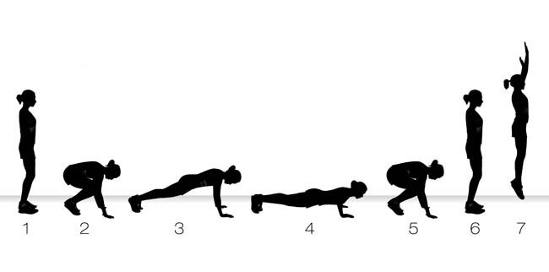
Burpee (30 Sec)

Slide 9
Change to Shoulder Taps

Slide 10
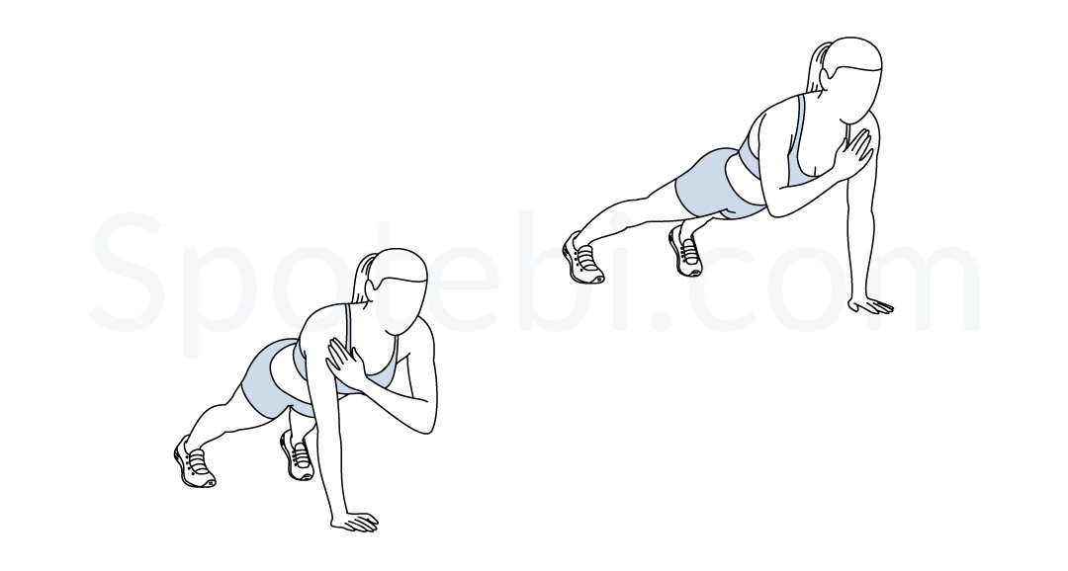
Shoulder Taps (30 Sec)

Slide 11
Change to Squat Jump

Slide 12
Squat Jump (40 Sec)

Slide 13
Change to Sit Up

Slide 14
Sit Up (40 Sec)

Slide 15
Change to Burpee

Slide 16
Burpee (40 Sec)

Slide 17
Change to Shoulder Taps

Slide 18
Shoulder Taps (40 Sec)

Slide 19
Change to Squat Jump

Slide 20
Squat Jump (50 Sec)

Slide 21
Change to Sit Up

Slide 22
Sit Up (50 Sec)

Slide 23
Change to Burpee

Slide 24
Burpee (50 Sec)

Slide 25
Change to Shoulder Taps

Slide 26
Shoulder Taps (50 Sec)

Slide 27
Change to Squat Jump

Slide 28
Squat Jump (60 Sec)

Slide 29
Change to Sit Up

Slide 30
Sit Up (60 Sec)

Slide 31
Change to Burpee

Slide 32
Burpee (60 Sec)

Slide 33
Change to Shoulder Taps

Slide 34
Shoulder Taps (60 Sec)

Slide 35
Water Break

Slide 36
Change to Squat Jump

Slide 37
Squat Jump (50 Sec)

Slide 38
Change to Sit Up

Slide 39
Sit Up (50 Sec)

Slide 40
Change to Burpee

Slide 41
Burpee (50 Sec)

Slide 42
Change to Shoulder Taps

Slide 43
Shoulder Taps (50 Sec)

Slide 44
Change to Squat Jump

Slide 45
Squat Jump (40 Sec)

Slide 46
Change to Sit Up

Slide 47
Sit Up (40 Sec)

Slide 48
Change to Burpee

Slide 49
Burpee (40 Sec)

Slide 50
Change to Shoulder Taps

Slide 51
Shoulder Taps (40 Sec)

Slide 52
1 Min 30 Sec Rest

Slide 53
Change to Lunges

Slide 54
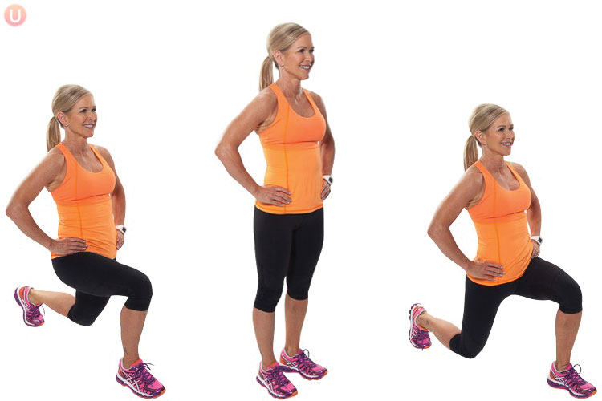
Lunge (30 Sec)

Slide 55
Change to Russian Twist

Slide 56
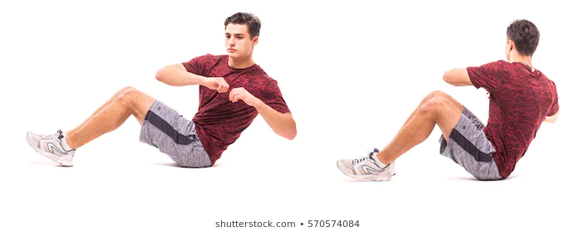
Russian Twist (30 Sec)

Slide 57
Change to Wall Sit

Slide 58
Wall Sit (30 Sec)

Slide 59
Change to Press Up

Slide 60
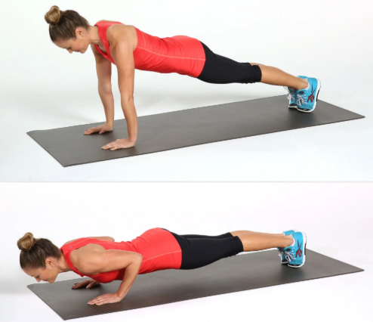
Press Up (30 Sec)

Slide 61
Change to Lunges

Slide 62
Lunge (40 Sec)

Slide 63
Change to Russian Twist

Slide 64
Russian Twist (40 Sec)

Slide 65
Change to Wall Sit

Slide 66
Wall Sit (40 Sec)

Slide 67
Change to Press Up

Slide 68
Press Up (40 Sec)

Slide 69
Change to Lunges

Slide 70
Lunge (50 Sec)

Slide 71
Change to Russian Twist

Slide 72
Russian Twist (50 Sec)

Slide 73
Change to Wall Sit

Slide 74
Wall Sit (50 Sec)

Slide 75
Change to Press Up

Slide 76
Press Up (50 Sec)

Slide 77
Change to Lunges

Slide 78
Lunge (60 Sec)

Slide 79
Change to Russian Twist

Slide 80
Russian Twist (60 Sec)

Slide 81
Change to Wall Sit

Slide 82
Wall Sit (60 Sec)

Slide 83
Change to Press Up

Slide 84
Press Up (60 Sec)

Slide 85
Water Break

Slide 86
Change to Lunges

Slide 87
Lunge (50 Sec)

Slide 88
Change to Russian Twist

Slide 89
Russian Twist (50 Sec)

Slide 90
Change to Wall Sit

Slide 91
Wall Sit (50 Sec)

Slide 92
Change to Press Up

Slide 93
Press Up (50 Sec)

Slide 94
Change to Lunges

Slide 95
Lunge (40 Sec)

Slide 96
Change to Russian Twist

Slide 97
Russian Twist (40 Sec)

Slide 98
Change to Wall Sit

Slide 99
Wall Sit (40 Sec)

Slide 100
Change to Press Up

Slide 101
Press Up (40 Sec)

Slide 102
Cool Down
5 Minutes

