Slide 1

Leicester RC Circuits

Slide 2
Warm Up
5 Minutes

Slide 3
Get Ready
5
4
3
2
1

Slide 4
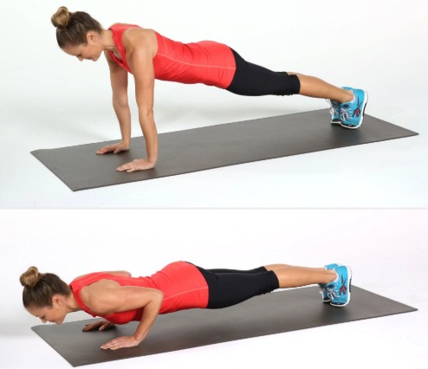
Press Up

Slide 5
Change to Lunges

Slide 6
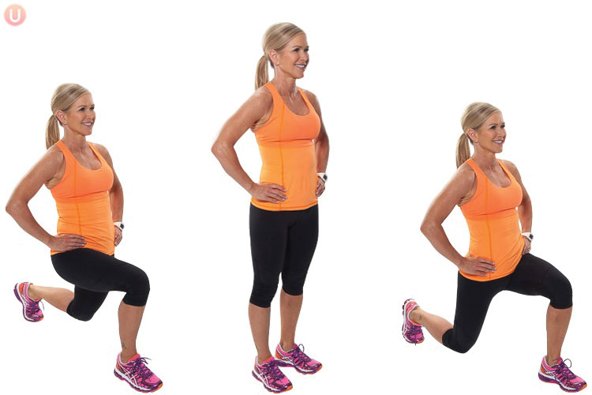
Lunge

Slide 7
Change to Front Plank

Slide 8
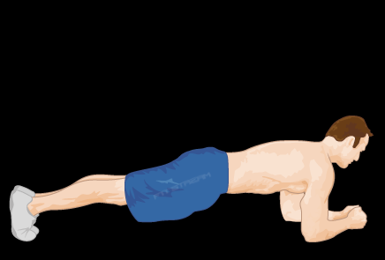
Front Plank

Slide 9
Change to Burpee

Slide 10
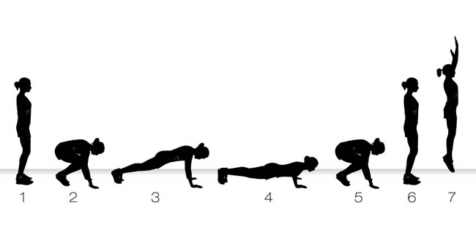
Burpee

Slide 11
Change to Russian Twist

Slide 12
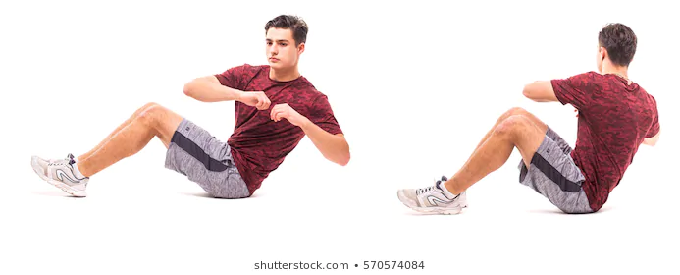
Russian Twist

Slide 13
Change to Squat Jump

Slide 14
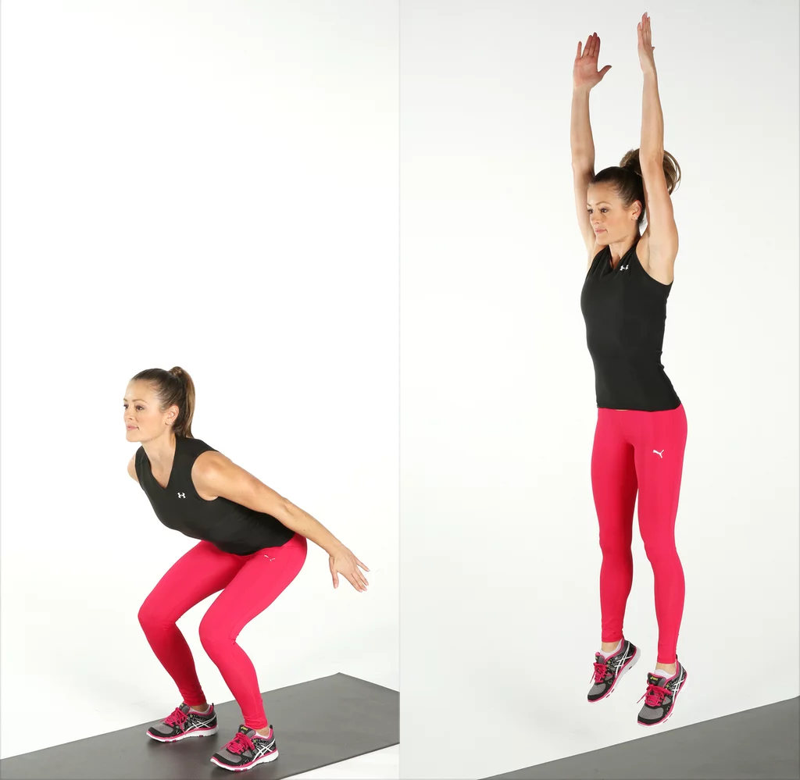
Squat Jump

Slide 15
Change to Tricep Dip

Slide 16
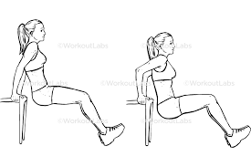
Tricep Dip

Slide 17
Change to Spiderman Plank

Slide 18
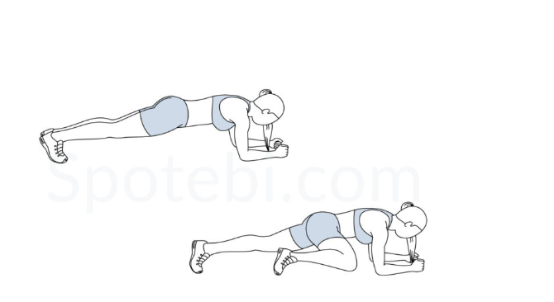
Spiderman Plank

Slide 19
Change to Mountain Climbers

Slide 20
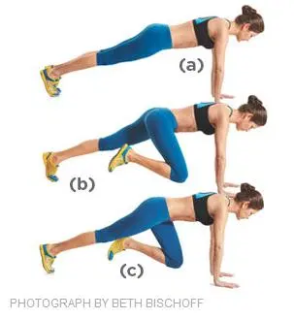
Mountain Cilmbers

Slide 21
Change to Dorsal Raise

Slide 22
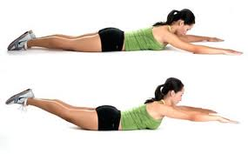
Dorsal Raise

Slide 23
Change to Sit Up

Slide 24
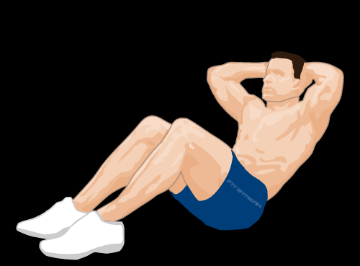
Sit Up

Slide 25
Change to Squat

Slide 26
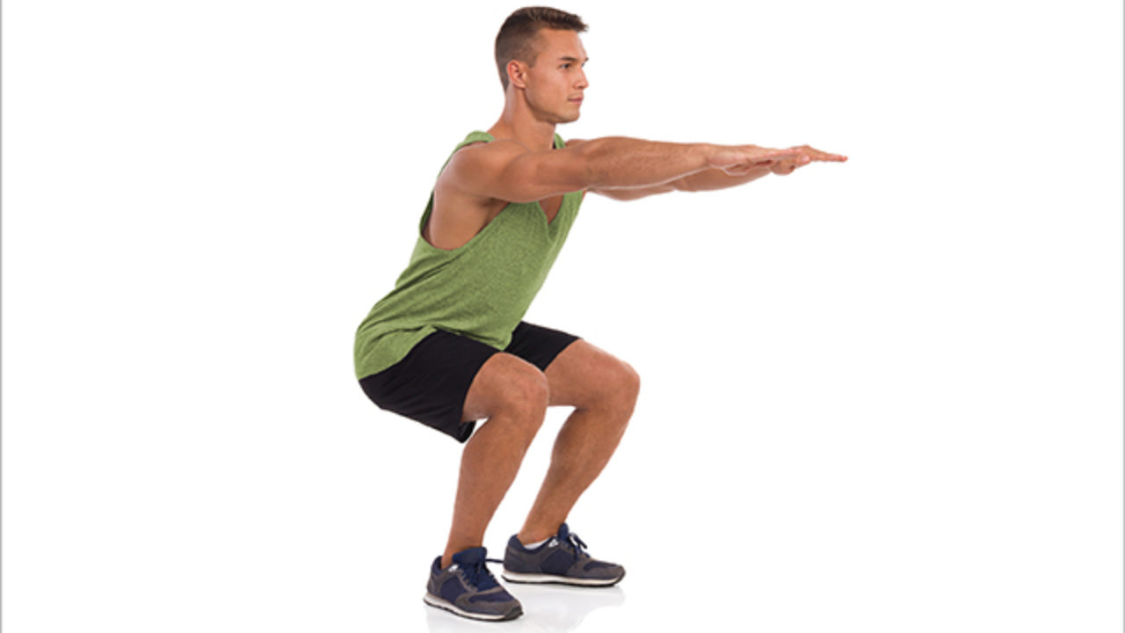
Squat

Slide 27
1 Min Rest

Slide 28
Change to Press Up

Slide 29
Press Up

Slide 30
Change to Lunges

Slide 31
Lunge

Slide 32
Change to Front Plank

Slide 33
Front Plank

Slide 34
Change to Burpee

Slide 35
Burpee

Slide 36
Change to Russian Twist

Slide 37
Russian Twist

Slide 38
Change to Squat Jump

Slide 39
Squat Jump

Slide 40
Change to Tricep Dip

Slide 41
Tricep Dip

Slide 42
Change to Spiderman Plank

Slide 43
Spiderman Plank

Slide 44
Change to Mountain Climbers

Slide 45
Mountain Cilmbers

Slide 46
Change to Dorsal Raise

Slide 47
Dorsal Raise

Slide 48
Change to Sit Up

Slide 49
Sit Up

Slide 50
Change to Squat

Slide 51
Squat

Slide 52
1 Min Rest

Slide 53
Change to Press Up

Slide 54
Press Up

Slide 55
Change to Lunges

Slide 56
Lunge

Slide 57
Change to Front Plank

Slide 58
Front Plank

Slide 59
Change to Burpee

Slide 60
Burpee

Slide 61
Change to Russian Twist

Slide 62
Russian Twist

Slide 63
Change to Squat Jump

Slide 64
Squat Jump

Slide 65
Change to Tricep Dip

Slide 66
Tricep Dip

Slide 67
Change to Spiderman Plank

Slide 68
Spiderman Plank

Slide 69
Change to Mountain Climbers

Slide 70
Mountain Cilmbers

Slide 71
Change to Dorsal Raise

Slide 72
Dorsal Raise

Slide 73
Change to Sit Up

Slide 74
Sit Up

Slide 75
Change to Squat

Slide 76
Squat

Slide 77
Cool Down
5 Minutes

