Slide 1
Leicester RC Circuits

Slide 2
Warm Up
5 Minutes

Slide 3
Get Ready
5
4
3
2
1

Slide 4
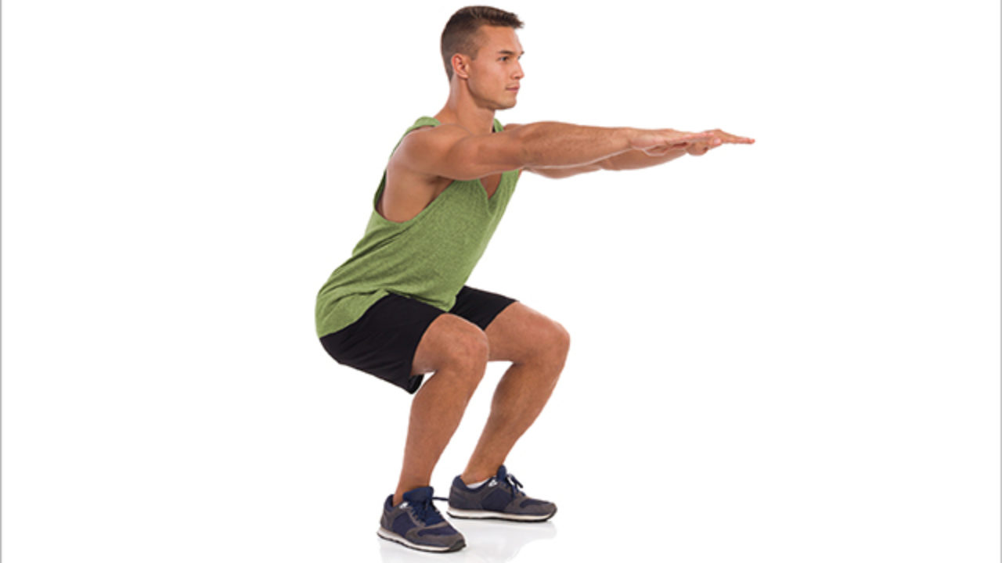
Squat

Slide 5
Change to Lunges

Slide 6
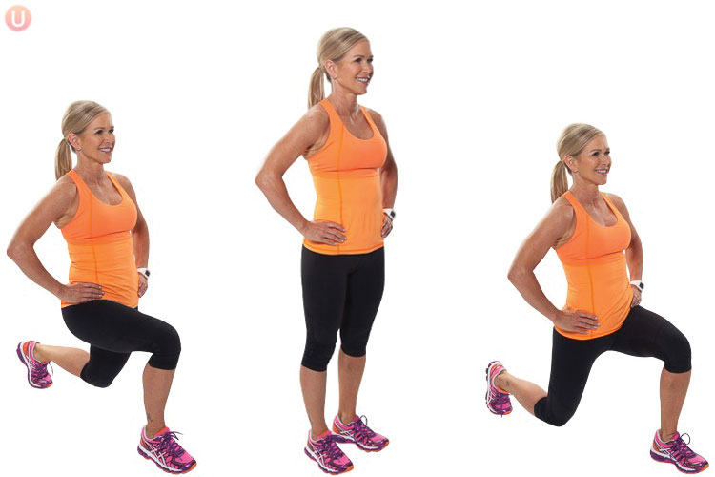
Lunge

Slide 7
Change to Burpee

Slide 8
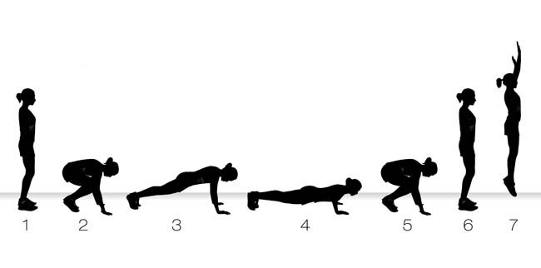
Burpee

Slide 9
Change to Calf Raises

Slide 10
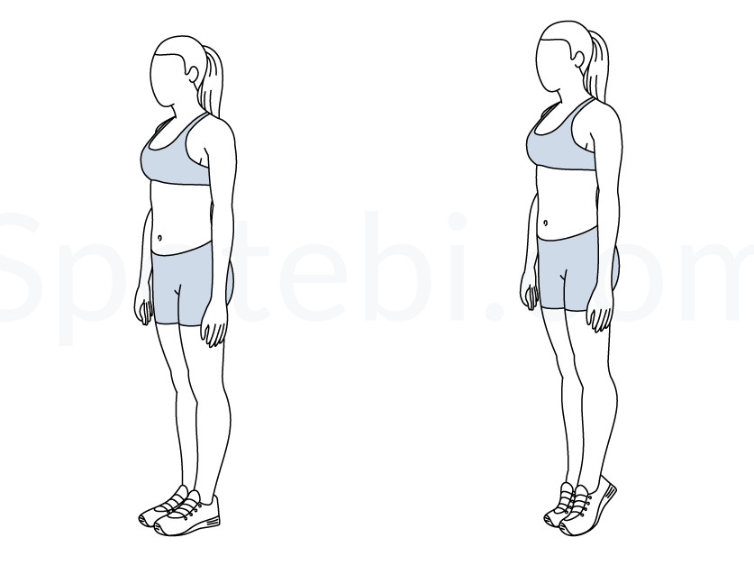
Calf Raises

Slide 11
Change to Squat Thrusts

Slide 12
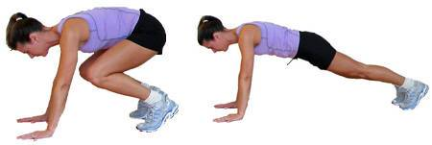
Squat Thrusts

Slide 13
Change to High Knees

Slide 14
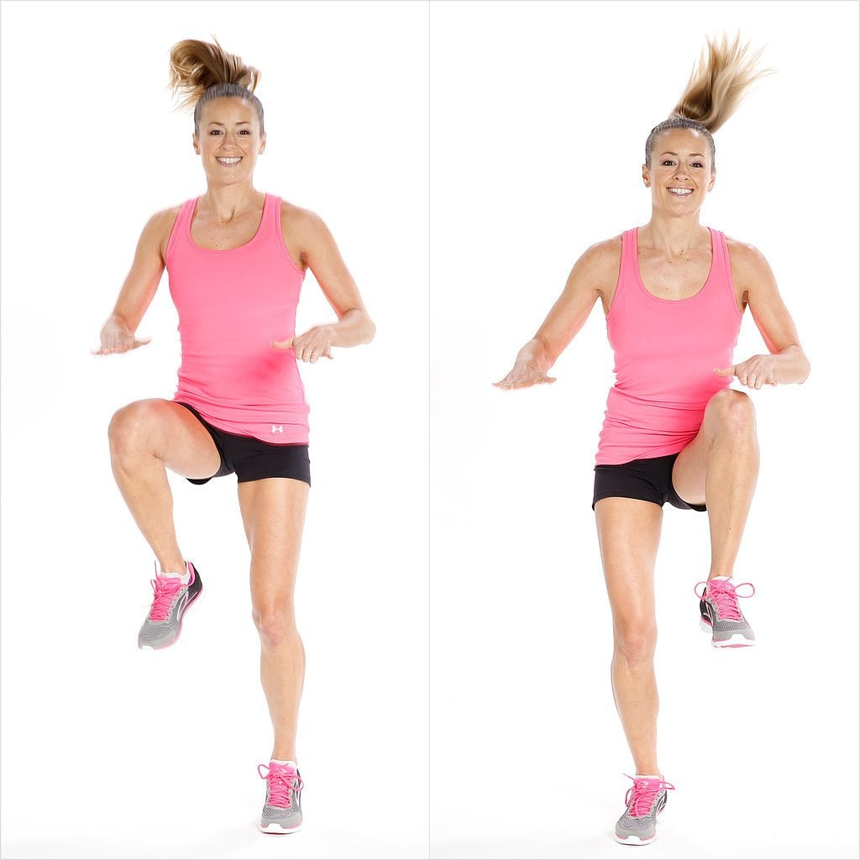
High Knees

Slide 15
Change to Side Jumps

Slide 16
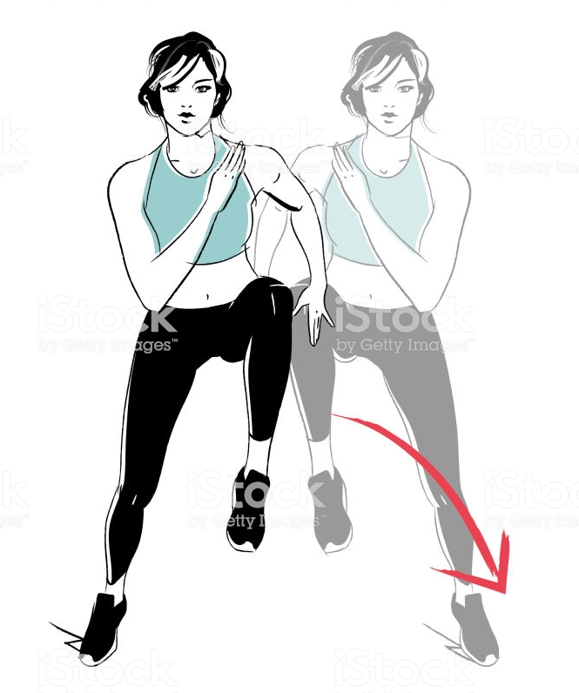
Side Jumps

Slide 17
Change to Heel Flicks

Slide 18
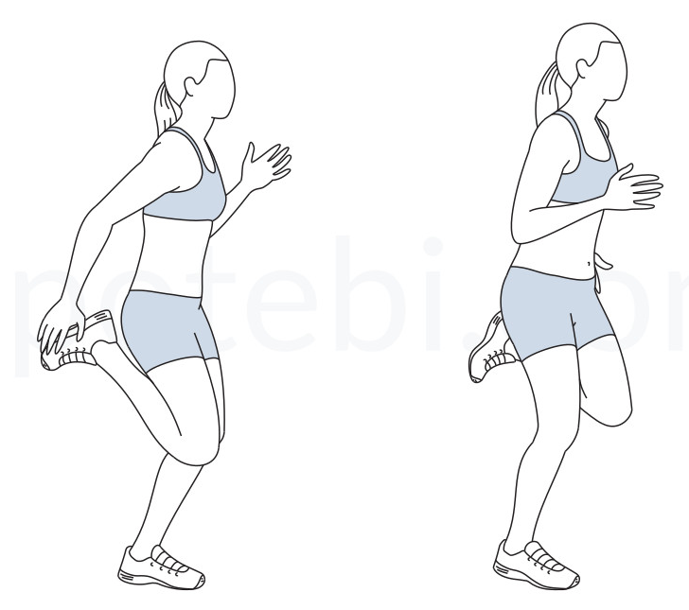
Heel Flicks

Slide 19
Change to Glute Bridge

Slide 20
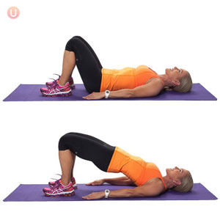
Glute Bridge

Slide 21
Change to Squat Jump

Slide 22
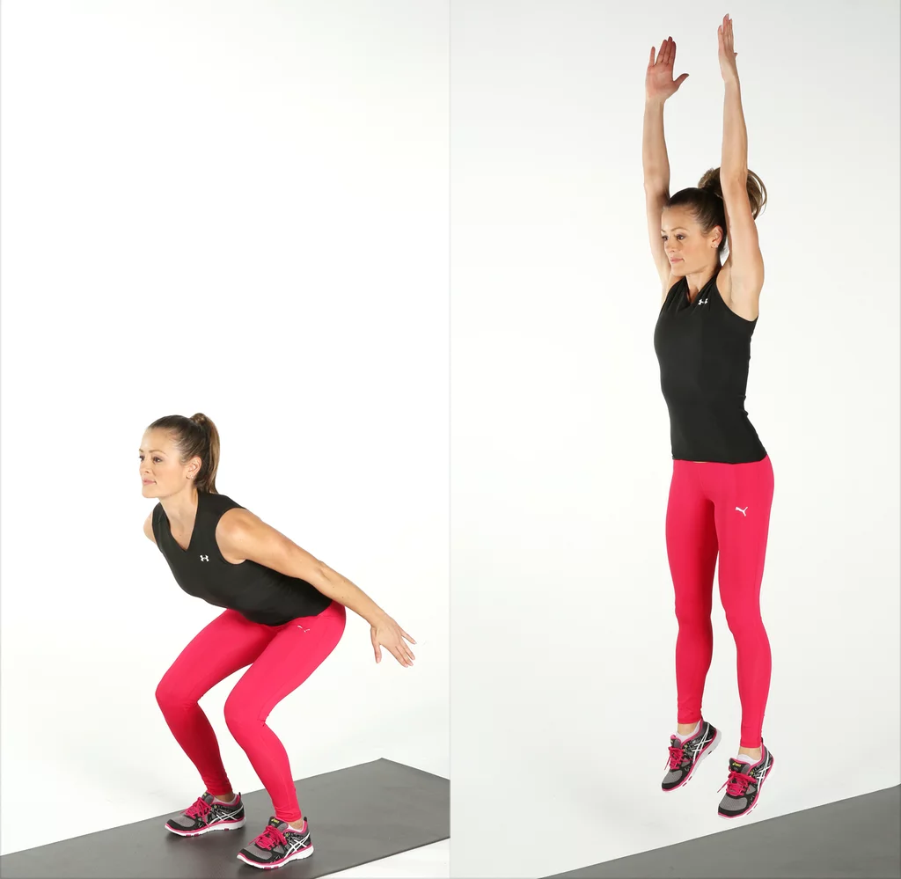
Squat Jump

Slide 23
Change to Star Jumps

Slide 24
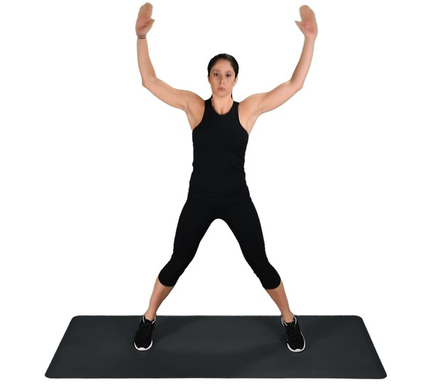
Star Jumps

Slide 25
Change to Mountain Climbers

Slide 26
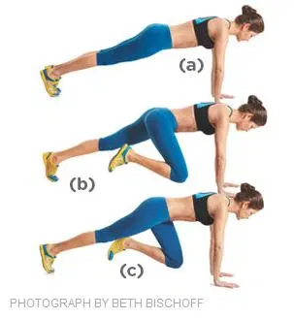
Mountain Climbers

Slide 27
Change to Wall Sit

Slide 28
Wall Sit

Slide 29
Get Ready to Squat

Slide 30
Squat

Slide 31
Change to Lunges

Slide 32
Lunge

Slide 33
Change to Burpee

Slide 34
Burpee

Slide 35
Change to Calf Raises

Slide 36
Calf Raises

Slide 37
Change to Squat Thrusts

Slide 38
Squat Thrusts

Slide 39
Change to High Knees

Slide 40
High Knees

Slide 41
Change to Side Jumps

Slide 42
Side Jumps

Slide 43
Change to Heel Flicks

Slide 44
Heel Flicks

Slide 45
Change to Glute Bridge

Slide 46
Glute Bridge

Slide 47
Change to Squat Jump

Slide 48
Squat Jump

Slide 49
Change to Star Jumps

Slide 50
Star Jumps

Slide 51
Change to Mountain Climbers

Slide 52
Mountain Climbers

Slide 53
Change to Wall Sit

Slide 54
Wall Sit

Slide 55
1:30 min Rest

Slide 56
Get Ready to Squat

Slide 57
Squat

Slide 58
Change to Lunges

Slide 59
Lunge

Slide 60
Change to Burpee

Slide 61
Burpee

Slide 62
Change to Calf Raises

Slide 63
Calf Raises

Slide 64
Change to Squat Thrusts

Slide 65
Squat Thrusts

Slide 66
Change to High Knees

Slide 67
High Knees

Slide 68
Change to Side Jumps

Slide 69
Side Jumps

Slide 70
Change to Heel Flicks

Slide 71
Heel Flicks

Slide 72
Change to Glute Bridge

Slide 73
Glute Bridge

Slide 74
Change to Squat Jump

Slide 75
Squat Jump

Slide 76
Change to Star Jumps

Slide 77
Star Jumps

Slide 78
Change to Mountain Climbers

Slide 79
Mountain Climbers

Slide 80
Change to Wall Sit

Slide 81
Wall Sit

Slide 82
Get Ready to Squat

Slide 83
Squat

Slide 84
Change to Lunges

Slide 85
Lunge

Slide 86
Change to Burpee

Slide 87
Burpee

Slide 88
Change to Calf Raises

Slide 89
Calf Raises

Slide 90
Change to Squat Thrusts

Slide 91
Squat Thrusts

Slide 92
Change to High Knees

Slide 93
High Knees

Slide 94
Change to Side Jumps

Slide 95
Side Jumps

Slide 96
Change to Heel Flicks

Slide 97
Heel Flicks

Slide 98
Change to Glute Bridge

Slide 99
Glute Bridge

Slide 100
Change to Squat Jump

Slide 101
Squat Jump

Slide 102
Change to Star Jumps

Slide 103
Star Jumps

Slide 104
Change to Mountain Climbers

Slide 105
Mountain Climbers

Slide 106
Change to Wall Sit

Slide 107
Wall Sit

