Slide 1
Leicester RC Circuits

Slide 2
Warm Up
5 Minutes

Slide 3
Get Ready
5
4
3
2
1

Slide 4
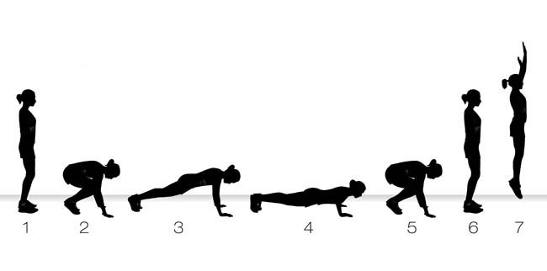
Burpee

Slide 5
Change to Star Jumps

Slide 6
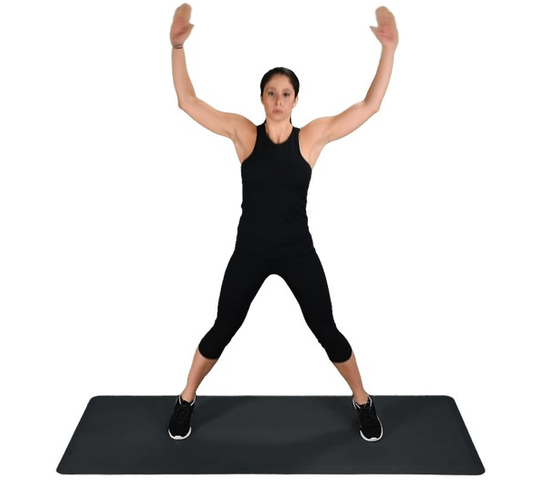
Star Jumps

Slide 7
Change to Squat

Slide 8
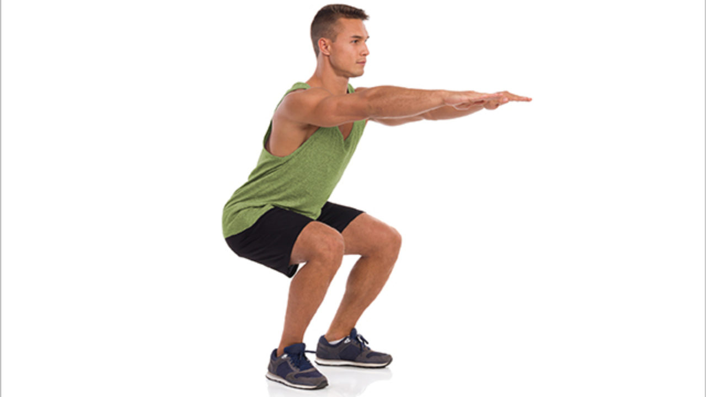
Squat

Slide 9
Change to Press Up

Slide 10
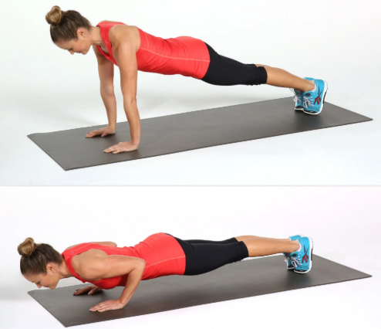
Press Up

Slide 11
Change to Sit Up

Slide 12
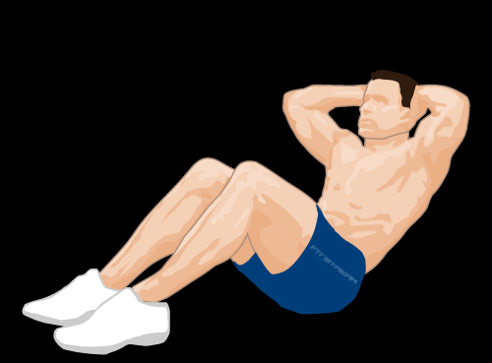
Sit Up

Slide 13
Change to Tricep Dip

Slide 14
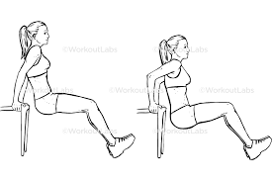
Tricep Dip

Slide 15
Change to High Knees

Slide 16
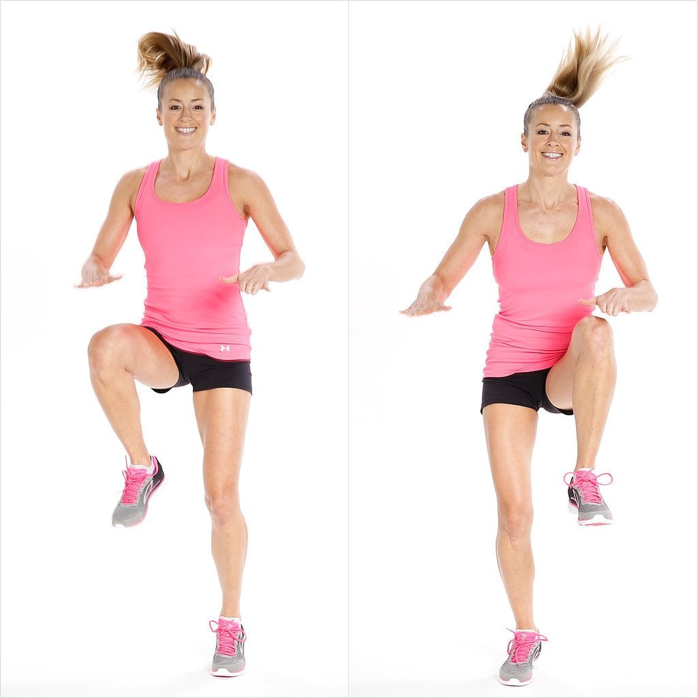
High Knees

Slide 17
Change to Mountain Climbers

Slide 18
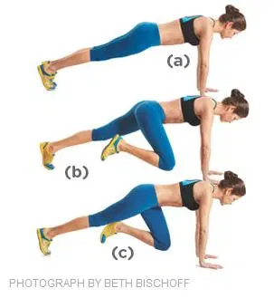
Mountain Climbers

Slide 19
Change to Squat Jump

Slide 20
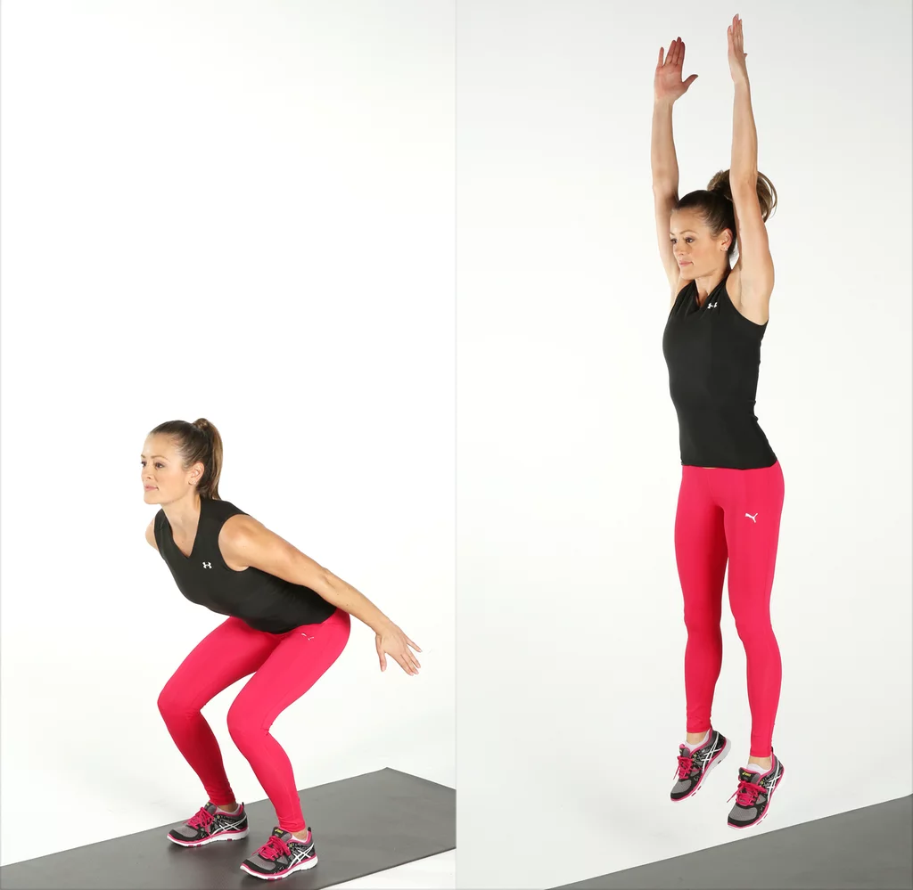
Squat Jump

Slide 21
Change to Lunges

Slide 22
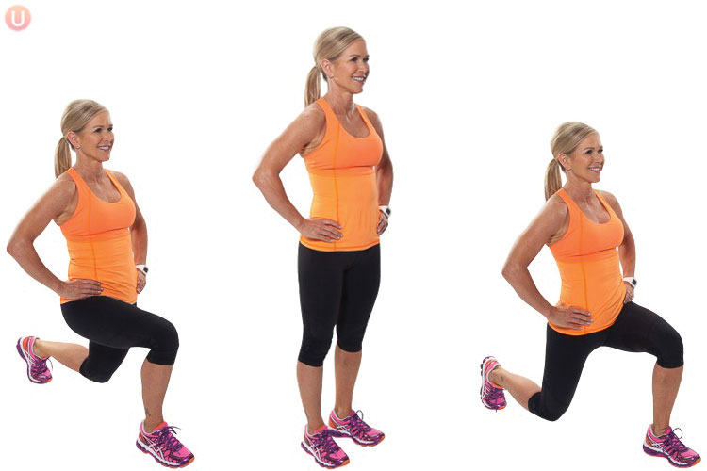
Lunge

Slide 23
Change to Calf Raises

Slide 24
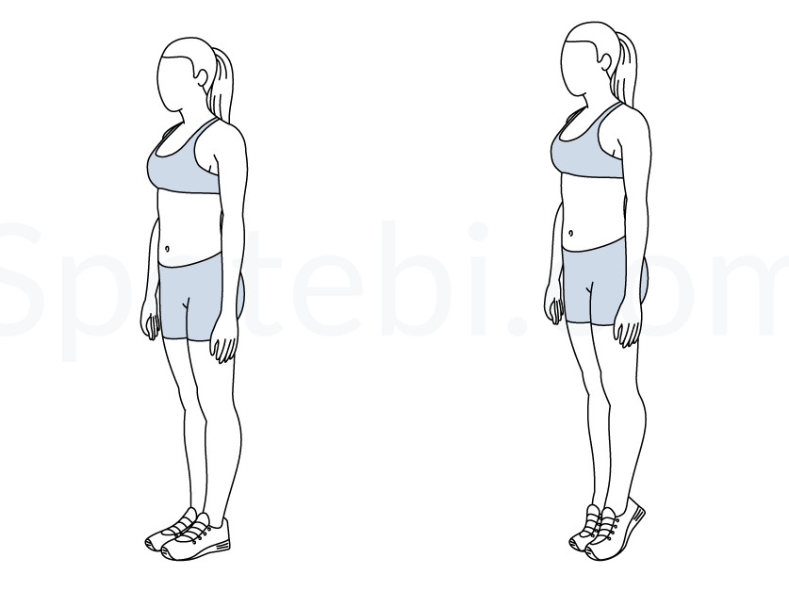
Calf Raises

Slide 25
Change to Squat Thrusts

Slide 26
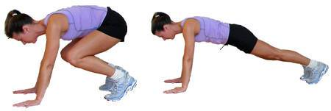
Squat Thrusts

Slide 27
Change to Burpee

Slide 28
Burpee

Slide 29
Change to Star Jumps

Slide 30
Star Jumps

Slide 31
Change to Squat

Slide 32
Squat

Slide 33
Change to Press Up

Slide 34
Press Up

Slide 35
Change to Sit Up

Slide 36
Sit Up

Slide 37
Change to Tricep Dip

Slide 38
Tricep Dip

Slide 39
Change to High Knees

Slide 40
High Knees

Slide 41
Change to Mountain Climbers

Slide 42
Mountain Climbers

Slide 43
Change to Squat Jump

Slide 44
Squat Jump

Slide 45
Change to Lunges

Slide 46
Lunge

Slide 47
Change to Calf Raises

Slide 48
Calf Raises

Slide 49
Change to Squat Thrusts

Slide 50
Squat Thrusts

Slide 51
1:30 min Rest

Slide 52
Change to Burpee

Slide 53
Burpee

Slide 54
Change to Star Jumps

Slide 55
Star Jumps

Slide 56
Change to Squat

Slide 57
Squat

Slide 58
Change to Press Up

Slide 59
Press Up

Slide 60
Change to Sit Up

Slide 61
Sit Up

Slide 62
Change to Tricep Dip

Slide 63
Tricep Dip

Slide 64
Change to High Knees

Slide 65
High Knees

Slide 66
Change to Mountain Climbers

Slide 67
Mountain Climbers

Slide 68
Change to Squat Jump

Slide 69
Squat Jump

Slide 70
Change to Lunges

Slide 71
Lunge

Slide 72
Change to Calf Raises

Slide 73
Calf Raises

Slide 74
Change to Squat Thrusts

Slide 75
Squat Thrusts

Slide 76
Change to Burpee

Slide 77
Burpee

Slide 78
Change to Star Jumps

Slide 79
Star Jumps

Slide 80
Change to Squat

Slide 81
Squat

Slide 82
Change to Press Up

Slide 83
Press Up

Slide 84
Change to Sit Up

Slide 85
Sit Up

Slide 86
Change to Tricep Dip

Slide 87
Tricep Dip

Slide 88
Change to High Knees

Slide 89
High Knees

Slide 90
Change to Mountain Climbers

Slide 91
Mountain Climbers

Slide 92
Change to Squat Jump

Slide 93
Squat Jump

Slide 94
Change to Lunges

Slide 95
Lunge

Slide 96
Change to Calf Raises

Slide 97
Calf Raises

Slide 98
Change to Squat Thrusts

Slide 99
Squat Thrusts

Slide 100
Core
8 minutes

