Slide 1
Leicester RC Circuits

Slide 2
Warm Up
5 Minutes

Slide 3
Get Ready
5
4
3
2
1

Slide 4
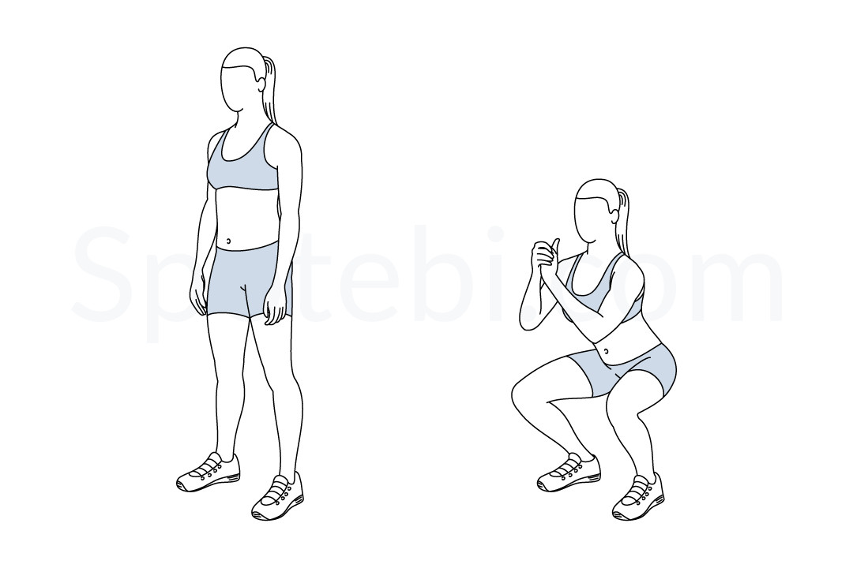
Squat (30 Sec)

Slide 5
Change to Tricep Dip

Slide 6
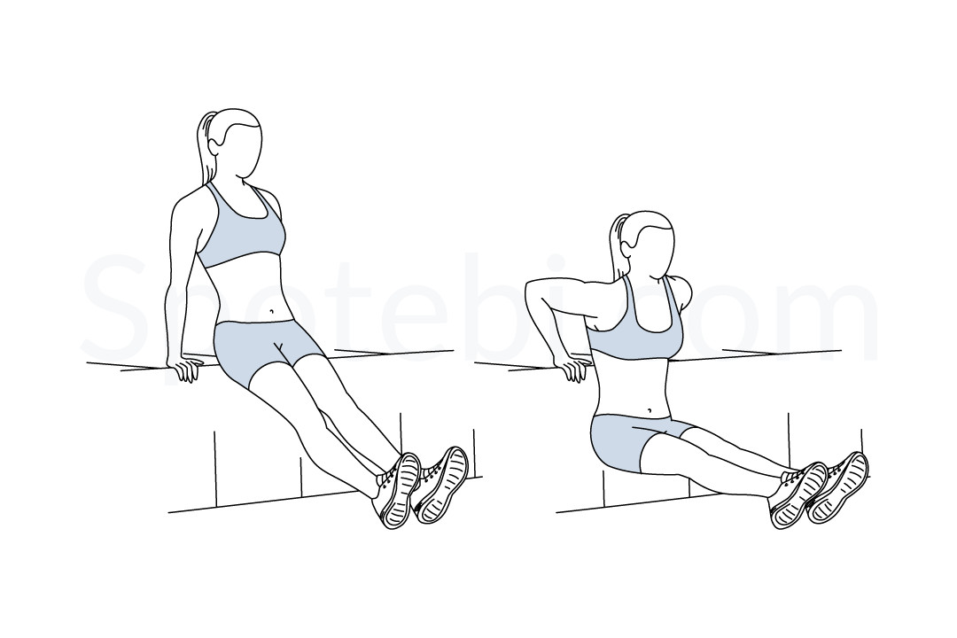
Tricep Dip (30 Sec)

Slide 7
Change to Squat Jump

Slide 8
Squat Jump (30 Sec)

Slide 9
Change to Lunges

Slide 10
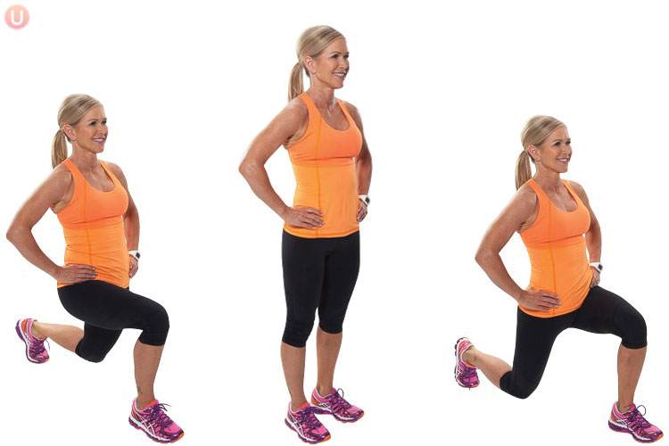
Lunge (30 Sec)

Slide 11
Change to Press Up

Slide 12
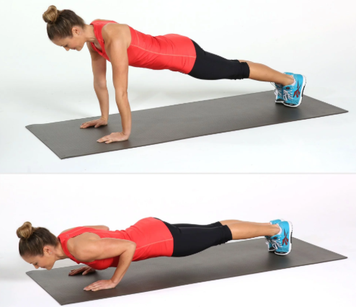
Press Up (30 Sec)

Slide 13
Change to Plank

Slide 14
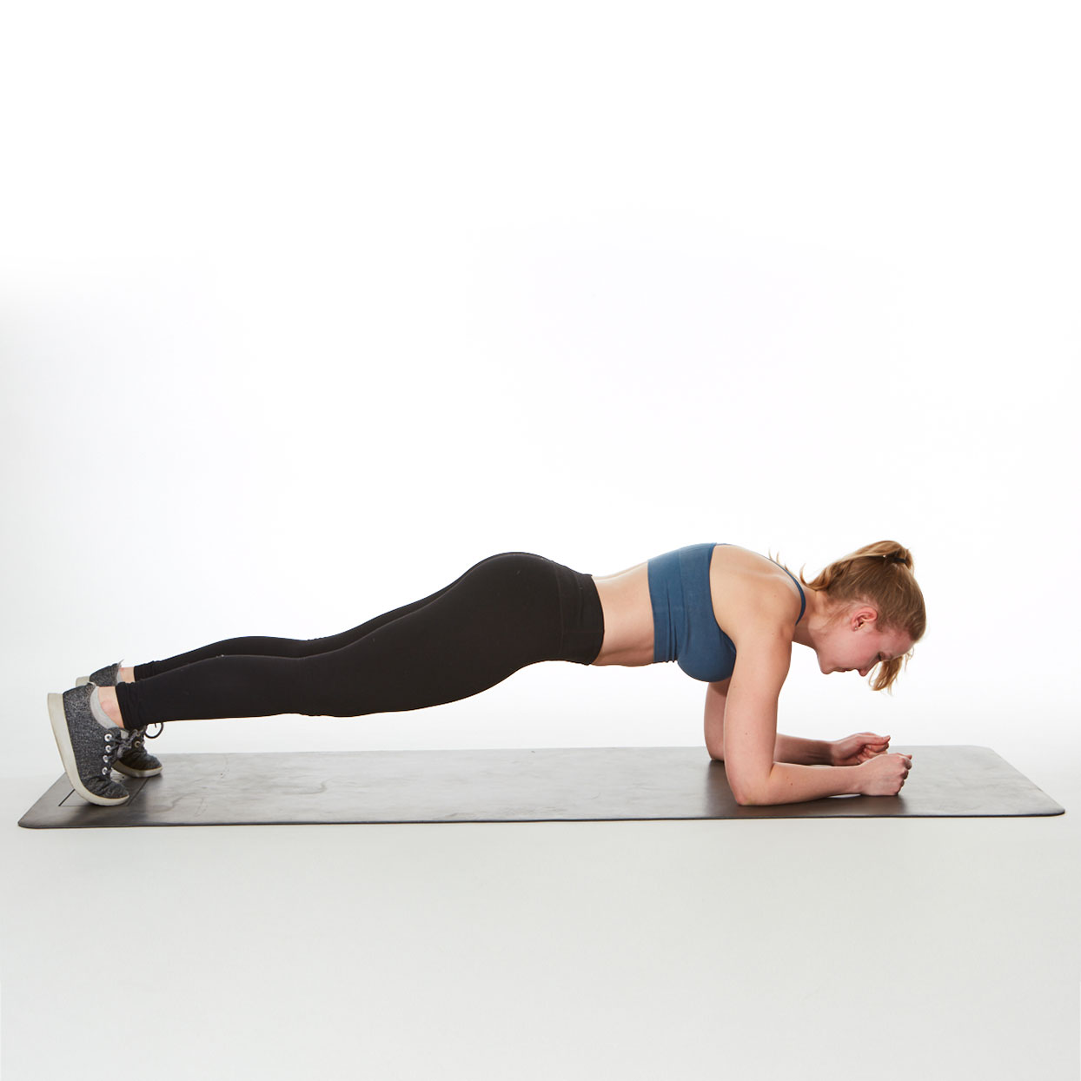
Plank (30 Sec)

Slide 15
Change to Squat

Slide 16
Squat (30 Sec)

Slide 17
Change to Tricep Dip

Slide 18
Tricep Dip (30 Sec)

Slide 19
Change to Squat Jump

Slide 20
Squat Jump (30 Sec)

Slide 21
Change to Lunges

Slide 22
Lunge (30 Sec)

Slide 23
Change to Press Up

Slide 24
Press Up (30 Sec)

Slide 25
Change to Plank

Slide 26
Plank (30 Sec)

Slide 27
Change to Squat

Slide 28
Squat (30 Sec)

Slide 29
Change to Tricep Dip

Slide 30
Tricep Dip (30 Sec)

Slide 31
Change to Squat Jump

Slide 32
Squat Jump (30 Sec)

Slide 33
Change to Lunges

Slide 34
Lunge (30 Sec)

Slide 35
Change to Press Up

Slide 36
Press Up (30 Sec)

Slide 37
Change to Plank

Slide 38
Plank (30 Sec)

Slide 39
Change to Squat

Slide 40
Squat (30 Sec)

Slide 41
Change to Tricep Dip

Slide 42
Tricep Dip (30 Sec)

Slide 43
Change to Squat Jump

Slide 44
Squat Jump (30 Sec)

Slide 45
Change to Lunges

Slide 46
Lunge (30 Sec)

Slide 47
Change to Press Up

Slide 48
Press Up (30 Sec)

Slide 49
Change to Plank

Slide 50
Plank (30 Sec)

Slide 51
Change to Squat

Slide 52
Squat (30 Sec)

Slide 53
Change to Tricep Dip

Slide 54
Tricep Dip (30 Sec)

Slide 55
Change to Squat Jump

Slide 56
Squat Jump (30 Sec)

Slide 57
Change to Lunges

Slide 58
Lunge (30 Sec)

Slide 59
Change to Press Up

Slide 60
Press Up (30 Sec)

Slide 61
Change to Plank

Slide 62
Plank (30 Sec)

Slide 63
1 Min 30 Sec Rest

Slide 64
Change to Squat

Slide 65
Squat (30 Sec)

Slide 66
Change to Tricep Dip

Slide 67
Tricep Dip (30 Sec)

Slide 68
Change to Squat Jump

Slide 69
Squat Jump (30 Sec)

Slide 70
Change to Lunges

Slide 71
Lunge (30 Sec)

Slide 72
Change to Press Up

Slide 73
Press Up (30 Sec)

Slide 74
Change to Plank

Slide 75
Plank (30 Sec)

Slide 76
Change to Squat

Slide 77
Squat (30 Sec)

Slide 78
Change to Tricep Dip

Slide 79
Tricep Dip (30 Sec)

Slide 80
Change to Squat Jump

Slide 81
Squat Jump (30 Sec)

Slide 82
Change to Lunges

Slide 83
Lunge (30 Sec)

Slide 84
Change to Press Up

Slide 85
Press Up (30 Sec)

Slide 86
Change to Plank

Slide 87
Plank (30 Sec)

Slide 88
Change to Squat

Slide 89
Squat (30 Sec)

Slide 90
Change to Tricep Dip

Slide 91
Tricep Dip (30 Sec)

Slide 92
Change to Squat Jump

Slide 93
Squat Jump (30 Sec)

Slide 94
Change to Lunges

Slide 95
Lunge (30 Sec)

Slide 96
Change to Press Up

Slide 97
Press Up (30 Sec)

Slide 98
Change to Plank

Slide 99
Plank (30 Sec)

Slide 100
Change to Squat

Slide 101
Squat (30 Sec)

Slide 102
Change to Tricep Dip

Slide 103
Tricep Dip (30 Sec)

Slide 104
Change to Squat Jump

Slide 105
Squat Jump (30 Sec)

Slide 106
Change to Lunges

Slide 107
Lunge (30 Sec)

Slide 108
Change to Press Up

Slide 109
Press Up (30 Sec)

Slide 110
Change to Plank

Slide 111
Plank (30 Sec)

Slide 112
Change to Squat

Slide 113
Squat (30 Sec)

Slide 114
Change to Tricep Dip

Slide 115
Tricep Dip (30 Sec)

Slide 116
Change to Squat Jump

Slide 117
Squat Jump (30 Sec)

Slide 118
Change to Lunges

Slide 119
Lunge (30 Sec)

Slide 120
Change to Press Up

Slide 121
Press Up (30 Sec)

Slide 122
Change to Plank

Slide 123
Plank (30 Sec)

Slide 124
8 Minutes Core

