Slide 1
Leicester RC Circuits

Slide 2
Warm Up
5 Minutes

Slide 3
Get Ready
5
4
3
2
1

Slide 4
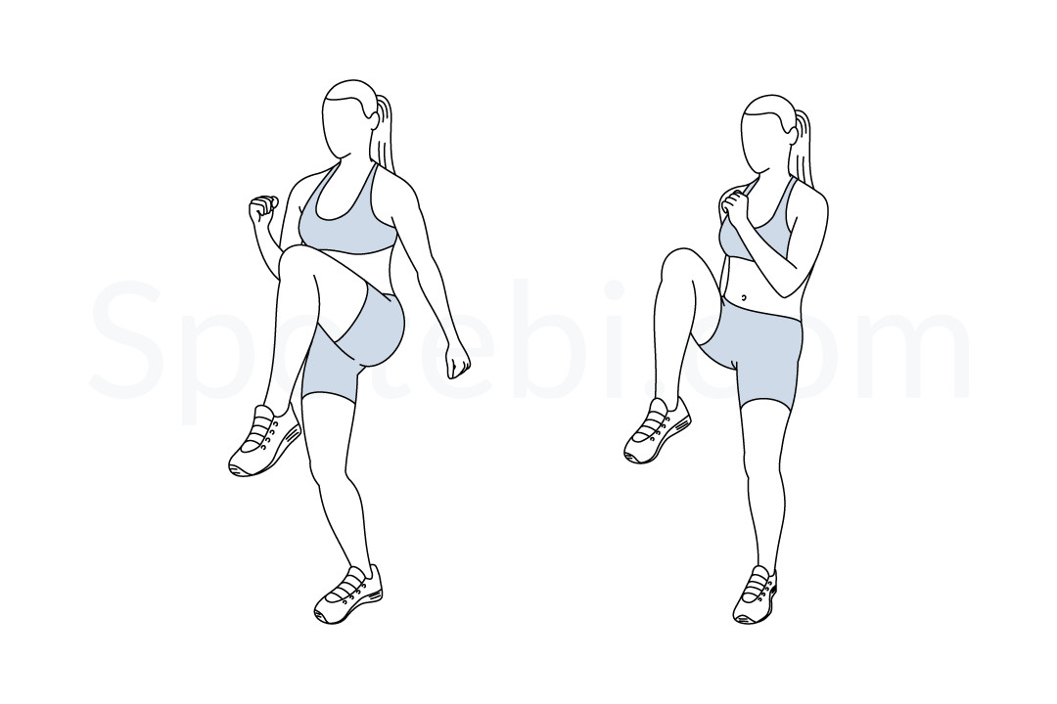
High Knees (30 Sec)

Slide 5
Change to Press Up

Slide 6
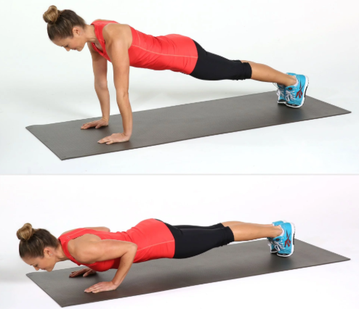
Press Up (30 Sec)

Slide 7
Change to Mountain Climbers

Slide 8
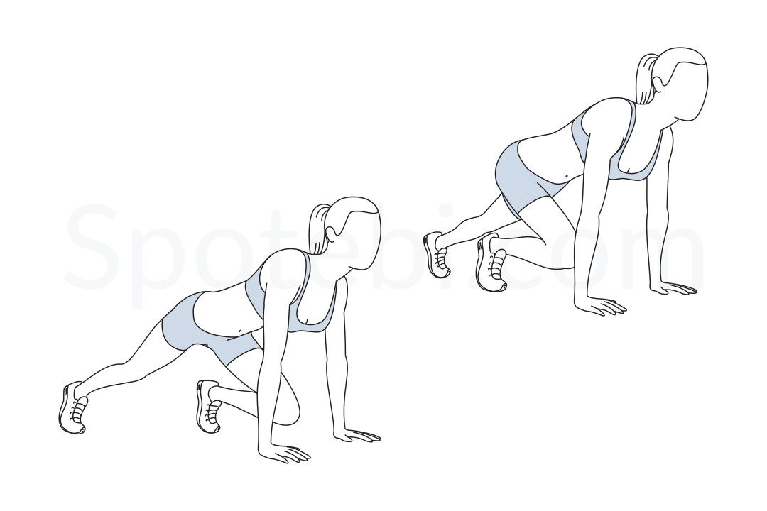
Mountain Climbers (30 Sec)

Slide 9
Change to Lunge with Knee Drive – Left Leg

Slide 10
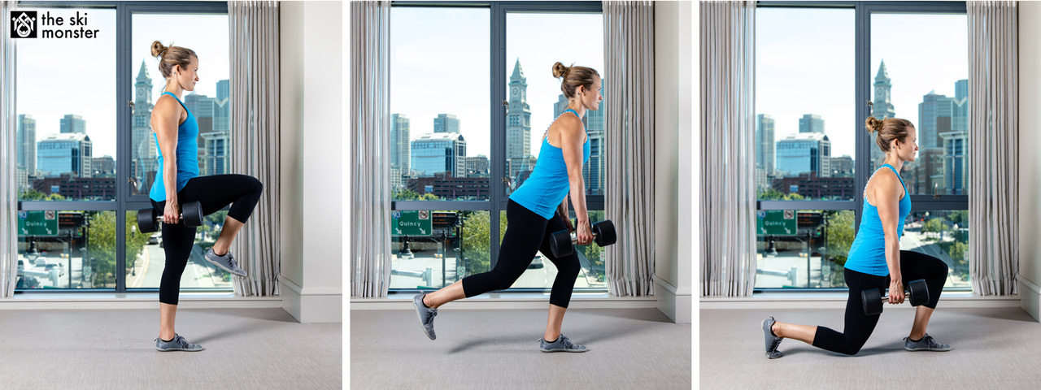
Lunge with Knee Drive – Left Leg (15 Sec)

Slide 11
Change to Lunge with Knee Drive – Right Leg

Slide 12
Lunge with Knee Drive – Right Leg (15 Sec)

Slide 13
Change to Burpee

Slide 14
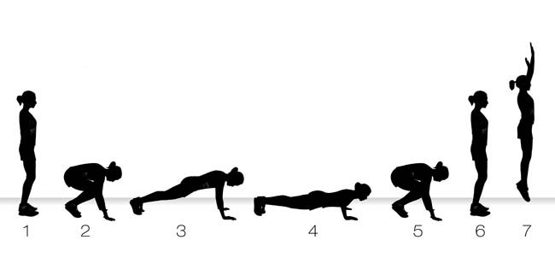
Burpee (30 Sec)

Slide 15
Change to Squat Jump

Slide 16
Squat Jump (30 Sec)

Slide 17
Change to High Knees

Slide 18
High Knees (30 Sec)

Slide 19
Change to Press Up

Slide 20
Press Up (30 Sec)

Slide 21
Change to Mountain Climbers

Slide 22
Mountain Climbers (30 Sec)

Slide 23
Change to Lunge with Knee Drive – Left Leg

Slide 24
Lunge with Knee Drive – Left Leg (15 Sec)

Slide 25
Change to Lunge with Knee Drive – Right Leg

Slide 26
Lunge with Knee Drive – Right Leg (15 Sec)

Slide 27
Change to Burpee

Slide 28
Burpee (30 Sec)

Slide 29
Change to Squat Jump

Slide 30
Squat Jump (30 Sec)

Slide 31
Change to High Knees

Slide 32
High Knees (30 Sec)

Slide 33
Change to Press Up

Slide 34
Press Up (30 Sec)

Slide 35
Change to Mountain Climbers

Slide 36
Mountain Climbers (30 Sec)

Slide 37
Change to Lunge with Knee Drive – Left Leg

Slide 38
Lunge with Knee Drive – Left Leg (15 Sec)

Slide 39
Change to Lunge with Knee Drive – Right Leg

Slide 40
Lunge with Knee Drive – Right Leg (15 Sec)

Slide 41
Change to Burpee

Slide 42
Burpee (30 Sec)

Slide 43
Change to Squat Jump

Slide 44
Squat Jump (30 Sec)

Slide 45
Change to High Knees

Slide 46
High Knees (30 Sec)

Slide 47
Change to Press Up

Slide 48
Press Up (30 Sec)

Slide 49
Change to Mountain Climbers

Slide 50
Mountain Climbers (30 Sec)

Slide 51
Change to Lunge with Knee Drive – Left Leg

Slide 52
Lunge with Knee Drive – Left Leg (15 Sec)

Slide 53
Change to Lunge with Knee Drive – Right Leg

Slide 54
Lunge with Knee Drive – Right Leg (15 Sec)

Slide 55
Change to Burpee

Slide 56
Burpee (30 Sec)

Slide 57
Change to Squat Jump

Slide 58
Squat Jump (30 Sec)

Slide 59
Change to High Knees

Slide 60
High Knees (30 Sec)

Slide 61
Change to Press Up

Slide 62
Press Up (30 Sec)

Slide 63
Change to Mountain Climbers

Slide 64
Mountain Climbers (30 Sec)

Slide 65
Change to Lunge with Knee Drive – Left Leg

Slide 66
Lunge with Knee Drive – Left Leg (15 Sec)

Slide 67
Change to Lunge with Knee Drive – Right Leg

Slide 68
Lunge with Knee Drive – Right Leg (15 Sec)

Slide 69
Change to Burpee

Slide 70
Burpee (30 Sec)

Slide 71
Change to Squat Jump

Slide 72
Squat Jump (30 Sec)

Slide 73
1 Min 30 Sec Rest

Slide 74
High Knees (30 Sec)

Slide 75
Change to Press Up

Slide 76
Press Up (30 Sec)

Slide 77
Change to Mountain Climbers

Slide 78
Mountain Climbers (30 Sec)

Slide 79
Change to Lunge with Knee Drive – Left Leg

Slide 80
Lunge with Knee Drive – Left Leg (15 Sec)

Slide 81
Change to Lunge with Knee Drive – Right Leg

Slide 82
Lunge with Knee Drive – Right Leg (15 Sec)

Slide 83
Change to Burpee

Slide 84
Burpee (30 Sec)

Slide 85
Change to Squat Jump

Slide 86
Squat Jump (30 Sec)

Slide 87
Change to High Knees

Slide 88
High Knees (30 Sec)

Slide 89
Change to Press Up

Slide 90
Press Up (30 Sec)

Slide 91
Change to Mountain Climbers

Slide 92
Mountain Climbers (30 Sec)

Slide 93
Change to Lunge with Knee Drive – Left Leg

Slide 94
Lunge with Knee Drive – Left Leg (15 Sec)

Slide 95
Change to Lunge with Knee Drive – Right Leg

Slide 96
Lunge with Knee Drive – Right Leg (15 Sec)

Slide 97
Change to Burpee

Slide 98
Burpee (30 Sec)

Slide 99
Change to Squat Jump

Slide 100
Squat Jump (30 Sec)

Slide 101
Change to High Knees

Slide 102
High Knees (30 Sec)

Slide 103
Change to Press Up

Slide 104
Press Up (30 Sec)

Slide 105
Change to Mountain Climbers

Slide 106
Mountain Climbers (30 Sec)

Slide 107
Change to Lunge with Knee Drive – Left Leg

Slide 108
Lunge with Knee Drive – Left Leg (15 Sec)

Slide 109
Change to Lunge with Knee Drive – Right Leg

Slide 110
Lunge with Knee Drive – Right Leg (15 Sec)

Slide 111
Change to Burpee

Slide 112
Burpee (30 Sec)

Slide 113
Change to Squat Jump

Slide 114
Squat Jump (30 Sec)

Slide 115
Change to High Knees

Slide 116
High Knees (30 Sec)

Slide 117
Change to Press Up

Slide 118
Press Up (30 Sec)

Slide 119
Change to Mountain Climbers

Slide 120
Mountain Climbers (30 Sec)

Slide 121
Change to Lunge with Knee Drive – Left Leg

Slide 122
Lunge with Knee Drive – Left Leg (15 Sec)

Slide 123
Change to Lunge with Knee Drive – Right Leg

Slide 124
Lunge with Knee Drive – Right Leg (15 Sec)

Slide 125
Change to Burpee

Slide 126
Burpee (30 Sec)

Slide 127
Change to Squat Jump

Slide 128
Squat Jump (30 Sec)

Slide 129
Change to High Knees

Slide 130
High Knees (30 Sec)

Slide 131
Change to Press Up

Slide 132
Press Up (30 Sec)

Slide 133
Change to Mountain Climbers

Slide 134
Mountain Climbers (30 Sec)

Slide 135
Change to Lunge with Knee Drive – Left Leg

Slide 136
Lunge with Knee Drive – Left Leg (15 Sec)

Slide 137
Change to Lunge with Knee Drive – Right Leg

Slide 138
Lunge with Knee Drive – Right Leg (15 Sec)

Slide 139
Change to Burpee

Slide 140
Burpee (30 Sec)

Slide 141
Change to Squat Jump

Slide 142
Squat Jump (30 Sec)

Slide 143
8 minute core

