Slide 1
Leicester RC Circuits

Slide 2
Warm Up
5 Minutes

Slide 3
Get Ready
5
4
3
2
1

Slide 4
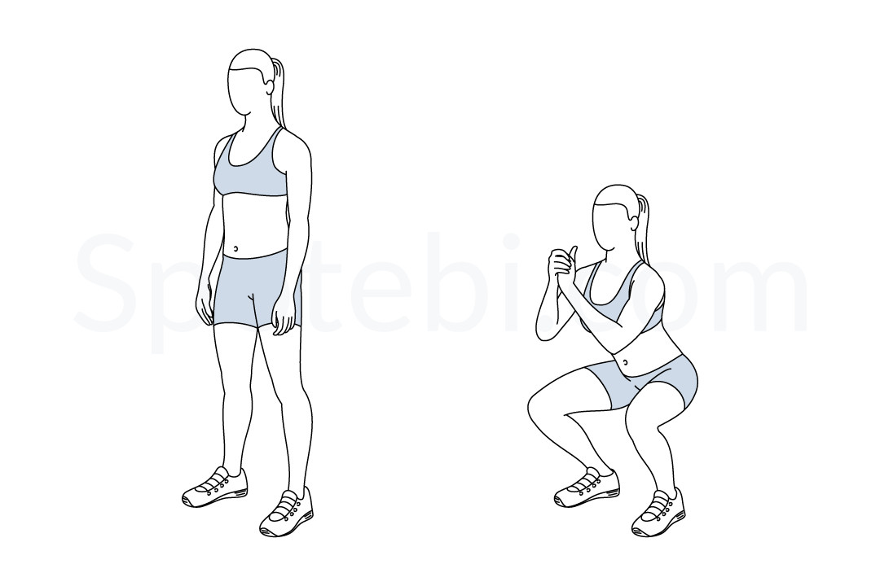
Squat (30 Sec)

Slide 5
Change to Press Up

Slide 6
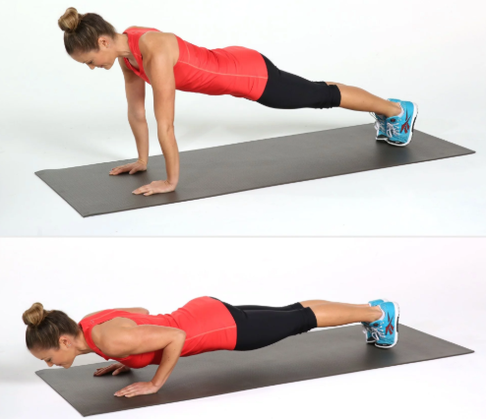
Press Up (30 Sec)

Slide 7
Change to Star Jumps

Slide 8
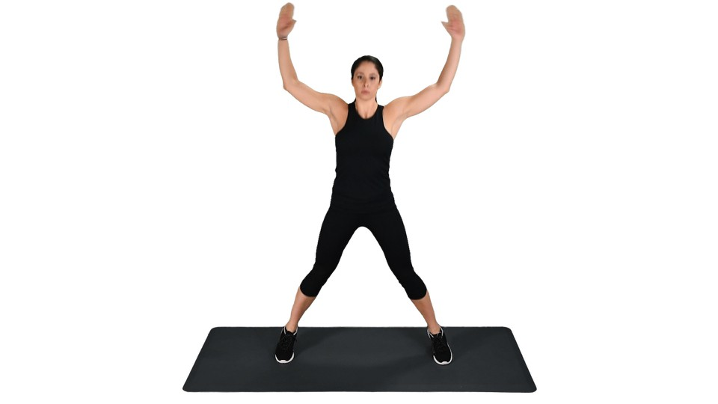
Star Jumps (30 Sec)

Slide 9
Change to Lunges

Slide 10
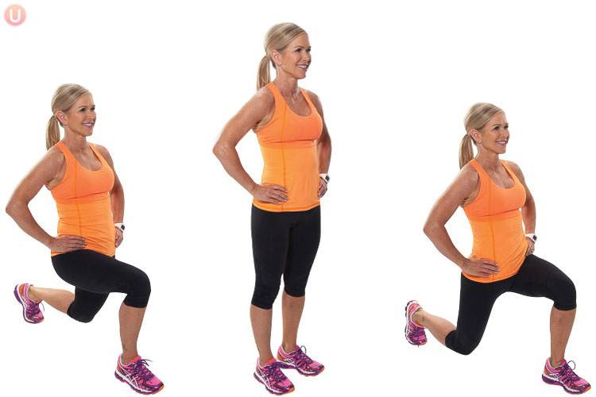
Lunge (30 Sec)

Slide 11
Change to Tricep Dip

Slide 12
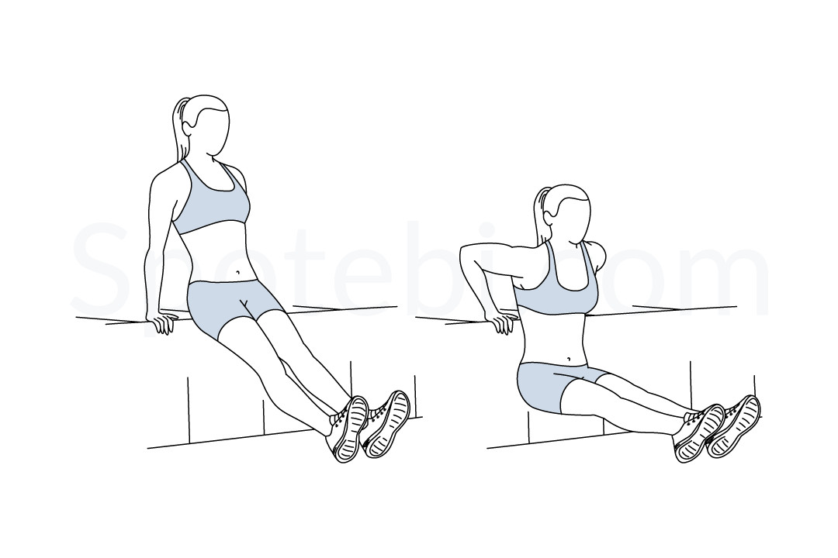
Tricep Dip (30 Sec)

Slide 13
Change to Sit Ups

Slide 14
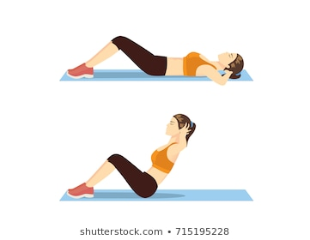
Sit Ups (30 Sec)

Slide 15
Change to Squat

Slide 16
Squat (30 Sec)

Slide 17
Change to Press Up

Slide 18
Press Up (30 Sec)

Slide 19
Change to Star Jumps

Slide 20
Star Jumps (30 Sec)

Slide 21
Change to Lunges

Slide 22
Lunge (30 Sec)

Slide 23
Change to Tricep Dip

Slide 24
Tricep Dip (30 Sec)

Slide 25
Change to Sit Ups

Slide 26
Sit Ups (30 Sec)

Slide 27
Change to Squat

Slide 28
Squat (30 Sec)

Slide 29
Change to Press Up

Slide 30
Press Up (30 Sec)

Slide 31
Change to Star Jumps

Slide 32
Star Jumps (30 Sec)

Slide 33
Change to Lunges

Slide 34
Lunge (30 Sec)

Slide 35
Change to Tricep Dip

Slide 36
Tricep Dip (30 Sec)

Slide 37
Change to Sit Ups

Slide 38
Sit Ups (30 Sec)

Slide 39
Change to Squat

Slide 40
Squat (30 Sec)

Slide 41
Change to Press Up

Slide 42
Press Up (30 Sec)

Slide 43
Change to Star Jumps

Slide 44
Star Jumps (30 Sec)

Slide 45
Change to Lunges

Slide 46
Lunge (30 Sec)

Slide 47
Change to Tricep Dip

Slide 48
Tricep Dip (30 Sec)

Slide 49
Change to Sit Ups

Slide 50
Sit Ups (30 Sec)

Slide 51
Change to Squat

Slide 52
Squat (30 Sec)

Slide 53
Change to Press Up

Slide 54
Press Up (30 Sec)

Slide 55
Change to Star Jumps

Slide 56
Star Jumps (30 Sec)

Slide 57
Change to Lunges

Slide 58
Lunge (30 Sec)

Slide 59
Change to Tricep Dip

Slide 60
Tricep Dip (30 Sec)

Slide 61
Change to Sit Ups

Slide 62
Sit Ups (30 Sec)

Slide 63
1 Min 30 Sec Rest

Slide 64
Change to Squat

Slide 65
Squat (30 Sec)

Slide 66
Change to Press Up

Slide 67
Press Up (30 Sec)

Slide 68
Change to Star Jumps

Slide 69
Star Jumps (30 Sec)

Slide 70
Change to Lunges

Slide 71
Lunge (30 Sec)

Slide 72
Change to Tricep Dip

Slide 73
Tricep Dip (30 Sec)

Slide 74
Change to Sit Ups

Slide 75
Sit Ups (30 Sec)

Slide 76
Change to Squat

Slide 77
Squat (30 Sec)

Slide 78
Change to Press Up

Slide 79
Press Up (30 Sec)

Slide 80
Change to Star Jumps

Slide 81
Star Jumps (30 Sec)

Slide 82
Change to Lunges

Slide 83
Lunge (30 Sec)

Slide 84
Change to Tricep Dip

Slide 85
Tricep Dip (30 Sec)

Slide 86
Change to Sit Ups

Slide 87
Sit Ups (30 Sec)

Slide 88
Change to Squat

Slide 89
Squat (30 Sec)

Slide 90
Change to Press Up

Slide 91
Press Up (30 Sec)

Slide 92
Change to Star Jumps

Slide 93
Star Jumps (30 Sec)

Slide 94
Change to Lunges

Slide 95
Lunge (30 Sec)

Slide 96
Change to Tricep Dip

Slide 97
Tricep Dip (30 Sec)

Slide 98
Change to Sit Ups

Slide 99
Sit Ups (30 Sec)

Slide 100
Change to Squat

Slide 101
Squat (30 Sec)

Slide 102
Change to Press Up

Slide 103
Press Up (30 Sec)

Slide 104
Change to Star Jumps

Slide 105
Star Jumps (30 Sec)

Slide 106
Change to Lunges

Slide 107
Lunge (30 Sec)

Slide 108
Change to Tricep Dip

Slide 109
Tricep Dip (30 Sec)

Slide 110
Change to Sit Ups

Slide 111
Sit Ups (30 Sec)

Slide 112
Change to Squat

Slide 113
Squat (30 Sec)

Slide 114
Change to Press Up

Slide 115
Press Up (30 Sec)

Slide 116
Change to Star Jumps

Slide 117
Star Jumps (30 Sec)

Slide 118
Change to Lunges

Slide 119
Lunge (30 Sec)

Slide 120
Change to Tricep Dip

Slide 121
Tricep Dip (30 Sec)

Slide 122
Change to Sit Ups

Slide 123
Sit Ups (30 Sec)

Slide 124
8 minute core

