Slide 1
Leicester RC Circuits

Slide 2
Warm Up
5 Minutes

Slide 3
Get Ready
5
4
3
2
1

Slide 4
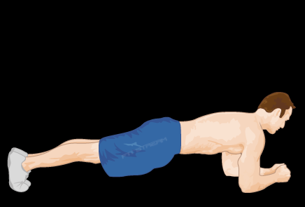
Front Plank

Slide 5
Change to LH Side Plank w/ Hip Dips

Slide 6
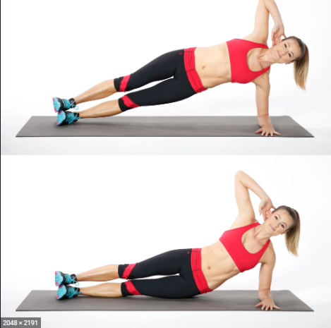
LH Side Plank w/ Hip Dips

Slide 7
Change to RH Side Plank w/ Hip Dips

Slide 8
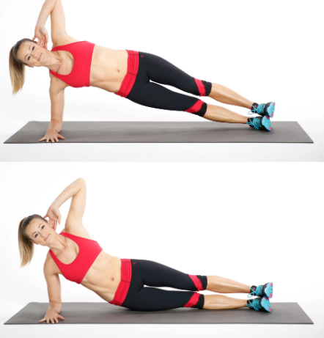
RH Side Plank w/ Hip Dips

Slide 9
Change to Squat

Slide 10
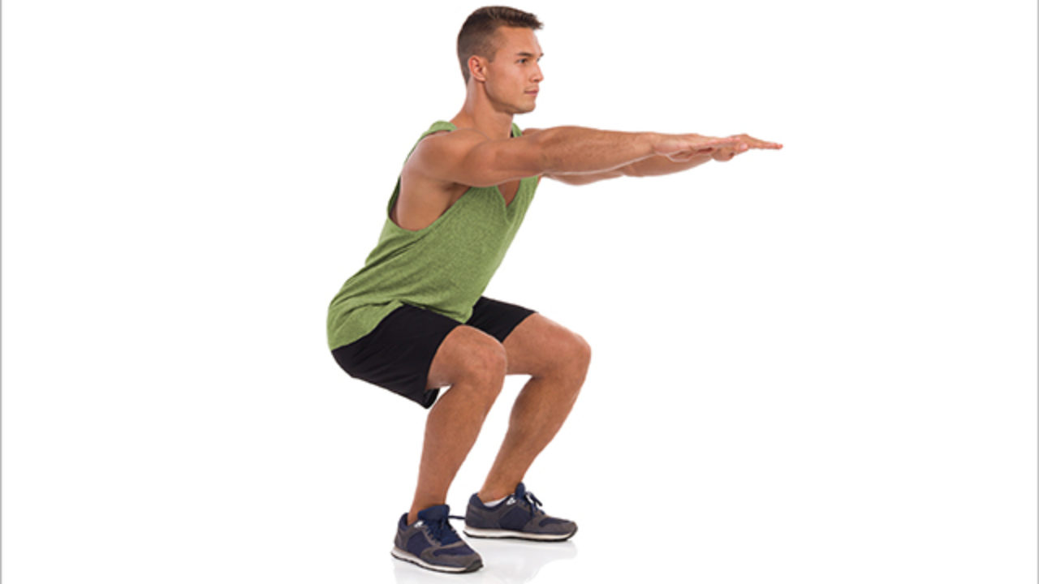
Squat

Slide 11
Change to Glute Bridge

Slide 12
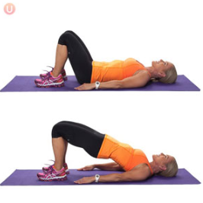
Glute Bridge

Slide 13
Change to Russian Twist

Slide 14
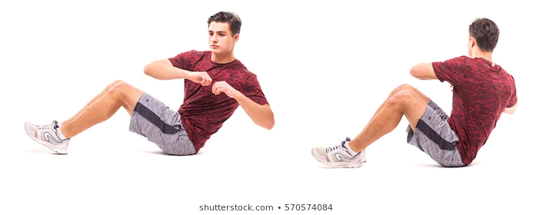
Russian Twist

Slide 15
Change to V-Sit

Slide 16
V-Sit

Slide 17
Change to Press Up

Slide 18
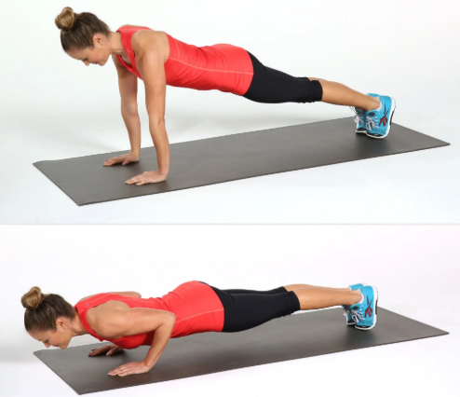
Press Up

Slide 19
Change to Leg Raises

Slide 20
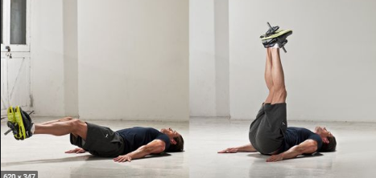
Leg Raises

Slide 21
Change to Commando’s

Slide 22
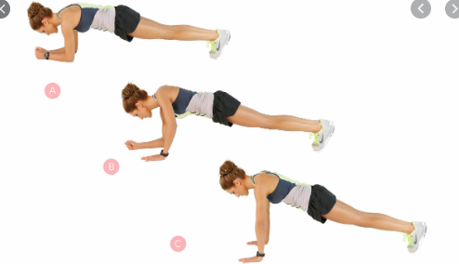
Commando’s

Slide 23
Change to Squat Jump

Slide 24
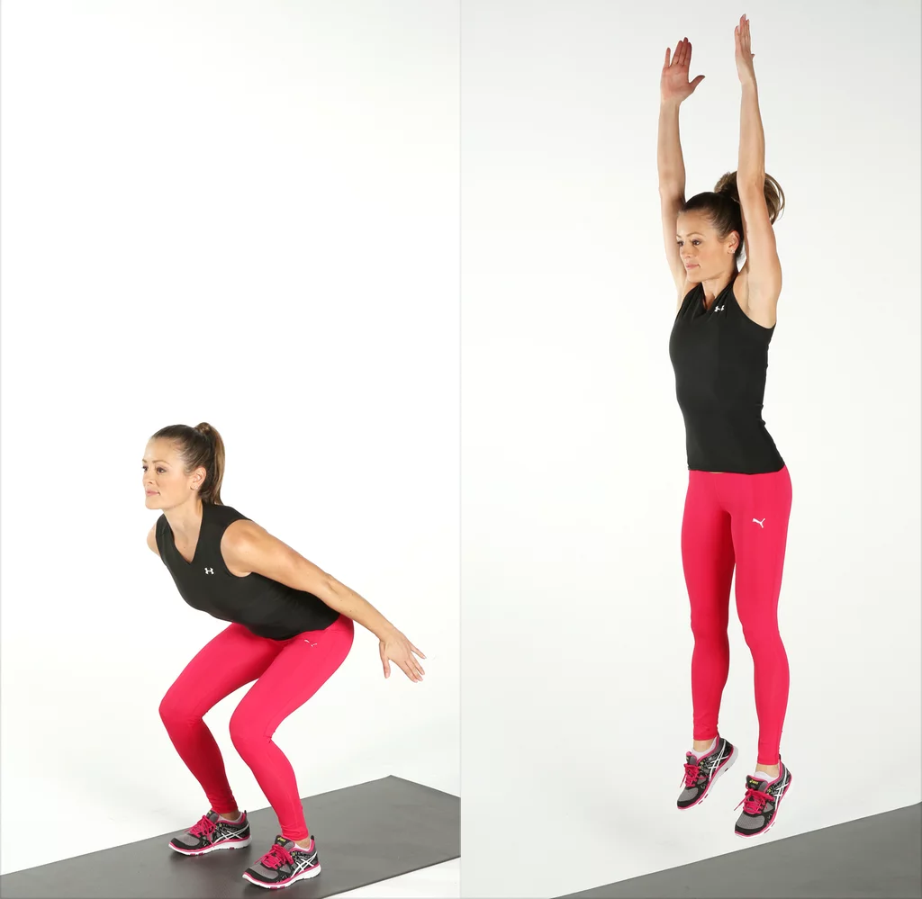
Squat Jump

Slide 25
Change to Heel Taps

Slide 26
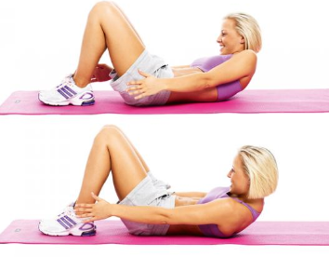
Heel Taps

Slide 27
Change to Leg Kicks

Slide 28
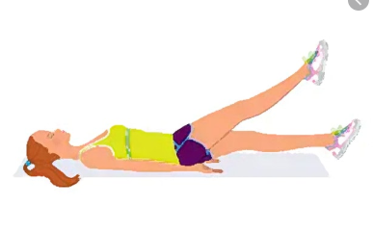
Leg Kicks

Slide 29
1 min Rest

Slide 30
Get Ready to Front Plank

Slide 31
Front Plank

Slide 32
Change to LH Side Plank w/ Hip Dips

Slide 33
LH Side Plank w/ Hip Dips

Slide 34
Change to RH Side Plank w/ Hip Dips

Slide 35
RH Side Plank w/ Hip Dips

Slide 36
Change to Squat

Slide 37
Squat

Slide 38
Change to Glute Bridge

Slide 39
Glute Bridge

Slide 40
Change to Russian Twist

Slide 41
Russian Twist

Slide 42
Change to V-Sit

Slide 43
V-Sit

Slide 44
Change to Press Up

Slide 45
Press Up

Slide 46
Change to Leg Raises

Slide 47
Leg Raises

Slide 48
Change to Commando’s

Slide 49
Commando’s

Slide 50
Change to Squat Jump

Slide 51
Squat Jump

Slide 52
Change to Heel Taps

Slide 53
Heel Taps

Slide 54
Change to Leg Kicks

Slide 55
Leg Kicks

Slide 56
1 min Rest

Slide 57
Get Ready to Front Plank

Slide 58
Front Plank

Slide 59
Change to LH Side Plank w/ Hip Dips

Slide 60
LH Side Plank w/ Hip Dips

Slide 61
Change to RH Side Plank w/ Hip Dips

Slide 62
RH Side Plank w/ Hip Dips

Slide 63
Change to Squat

Slide 64
Squat

Slide 65
Change to Glute Bridge

Slide 66
Glute Bridge

Slide 67
Change to Russian Twist

Slide 68
Russian Twist

Slide 69
Change to V-Sit

Slide 70
V-Sit

Slide 71
Change to Press Up

Slide 72
Press Up

Slide 73
Change to Leg Raises

Slide 74
Leg Raises

Slide 75
Change to Commando’s

Slide 76
Commando’s

Slide 77
Change to Squat Jump

Slide 78
Squat Jump

Slide 79
Change to Heel Taps

Slide 80
Heel Taps

Slide 81
Change to Leg Kicks

Slide 82
Leg Kicks

Slide 83
Cool Down
5 Minutes

