Slide 1
Leicester RC Circuits

Slide 2
Warm Up
5 Minutes

Slide 3
Get Ready
5
4
3
2
1

Slide 4
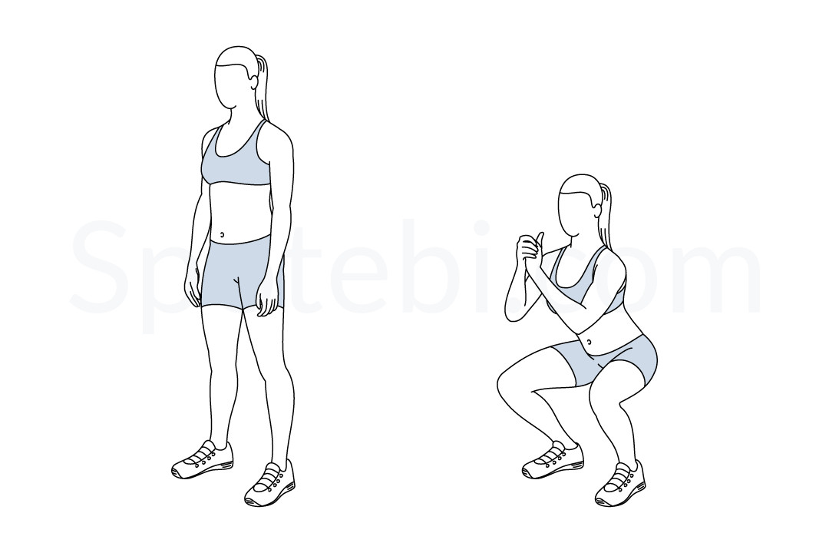
Squat (30 Sec)

Slide 5
Change to Tricep Dip

Slide 6
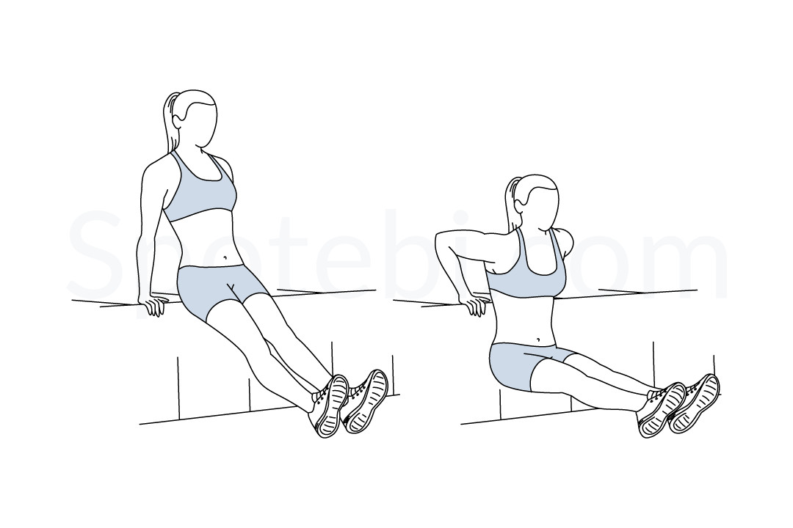
Tricep Dip (30 Sec)

Slide 7
Change to Burpee

Slide 8
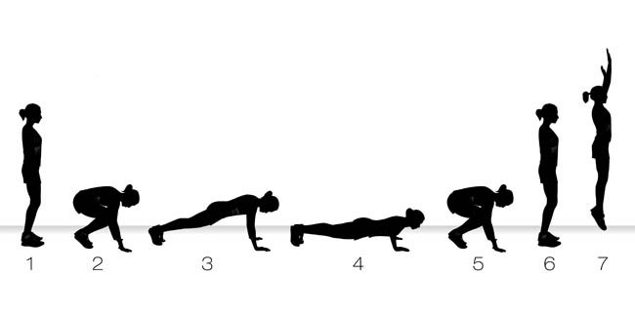
Burpee (30 Sec)

Slide 9
Change to Lunges

Slide 10
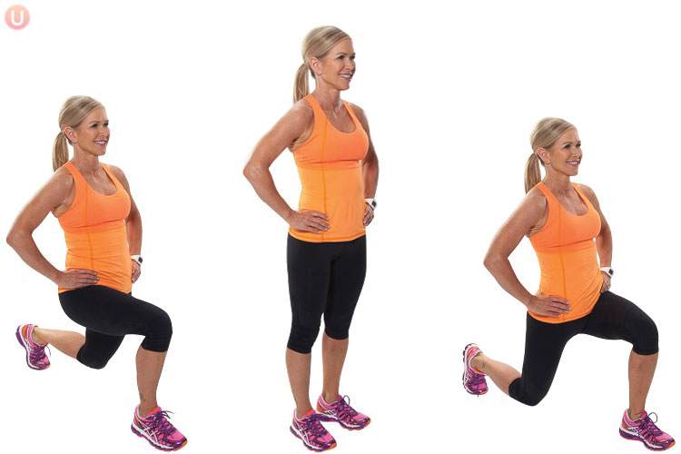
Lunge (30 Sec)

Slide 11
Change to Press Up

Slide 12
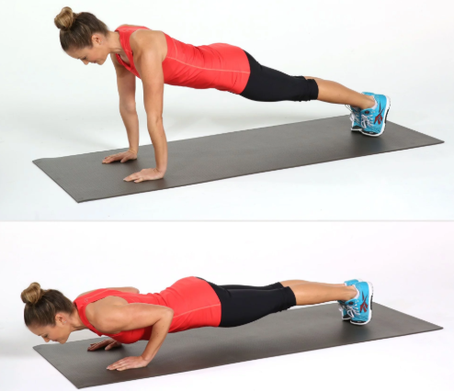
Press Up (30 Sec)

Slide 13
Change to Plank

Slide 14
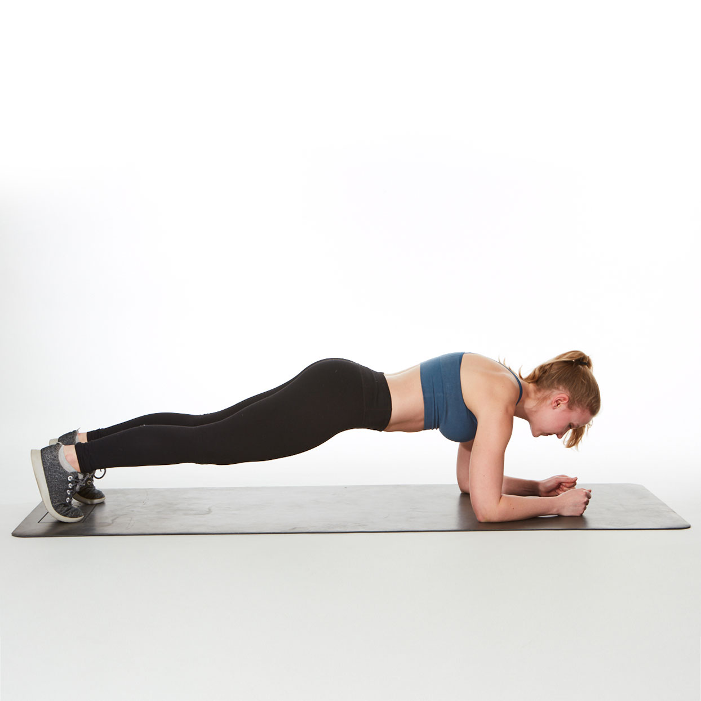
Plank (30 Sec)

Slide 15
Change to Squat

Slide 16
Squat (30 Sec)

Slide 17
Change to Tricep Dip

Slide 18
Tricep Dip (30 Sec)

Slide 19
Change to Burpee

Slide 20
Burpee (30 Sec)

Slide 21
Change to Lunges

Slide 22
Lunge (30 Sec)

Slide 23
Change to Press Up

Slide 24
Press Up (30 Sec)

Slide 25
Change to Plank

Slide 26
Plank (30 Sec)

Slide 27
Change to Squat

Slide 28
Squat (30 Sec)

Slide 29
Change to Tricep Dip

Slide 30
Tricep Dip (30 Sec)

Slide 31
Change to Burpee

Slide 32
Burpee (30 Sec)

Slide 33
Change to Lunges

Slide 34
Lunge (30 Sec)

Slide 35
Change to Press Up

Slide 36
Press Up (30 Sec)

Slide 37
Change to Plank

Slide 38
Plank (30 Sec)

Slide 39
1 Min 30 Sec Rest

Slide 40
Change to Squat

Slide 41
Squat (30 Sec)

Slide 42
Change to Tricep Dip

Slide 43
Tricep Dip (30 Sec)

Slide 44
Change to Burpee

Slide 45
Burpee (30 Sec)

Slide 46
Change to Lunges

Slide 47
Lunge (30 Sec)

Slide 48
Change to Press Up

Slide 49
Press Up (30 Sec)

Slide 50
Change to Plank

Slide 51
Plank (30 Sec)

Slide 52
Change to Squat

Slide 53
Squat (30 Sec)

Slide 54
Change to Tricep Dip

Slide 55
Tricep Dip (30 Sec)

Slide 56
Change to Burpee

Slide 57
Burpee (30 Sec)

Slide 58
Change to Lunges

Slide 59
Lunge (30 Sec)

Slide 60
Change to Press Up

Slide 61
Press Up (30 Sec)

Slide 62
Change to Plank

Slide 63
Plank (30 Sec)

Slide 64
Change to Squat

Slide 65
Squat (30 Sec)

Slide 66
Change to Tricep Dip

Slide 67
Tricep Dip (30 Sec)

Slide 68
Change to Burpee

Slide 69
Burpee (30 Sec)

Slide 70
Change to Lunges

Slide 71
Lunge (30 Sec)

Slide 72
Change to Press Up

Slide 73
Press Up (30 Sec)

Slide 74
Change to Plank

Slide 75
Plank (30 Sec)

Slide 76
8 Minutes Core

