Slide 1
Warm Up
5 Minutes

Slide 2
Get Ready
5
4
3
2
1

Slide 3
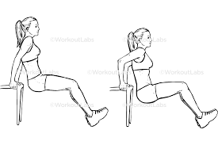
Tricept Dip (30 Sec)

Slide 4
Change to Sit Up

Slide 5
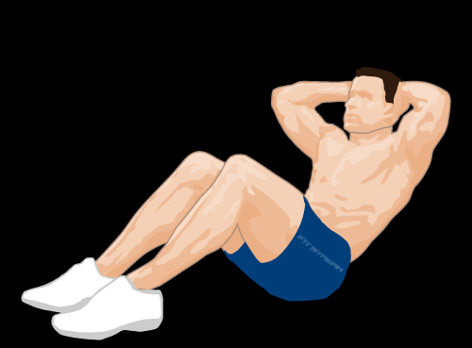
Sit Up (30 Sec)

Slide 6
Change to Burpee

Slide 7
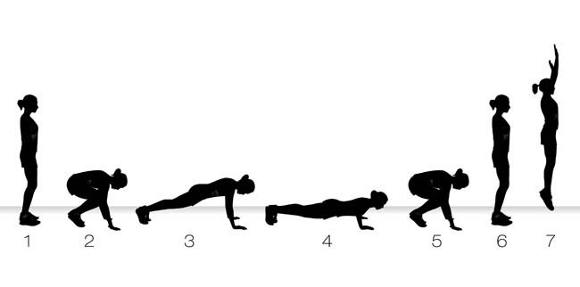
Burpee (30 Sec)

Slide 8
Change to Star Jumps

Slide 9
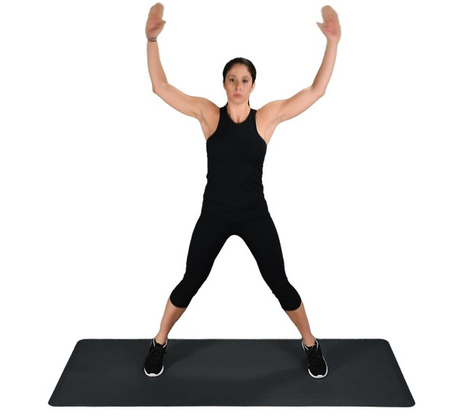
Star Jump (30 Sec)

Slide 10
Change to Tricep Dips

Slide 11
Tricep Dips (40 Sec)

Slide 12
Change to Sit Up

Slide 13
Sit Up (40 Sec)

Slide 14
Change to Burpee

Slide 15
Burpee (40 Sec)

Slide 16
Change to Star Jumps

Slide 17
Star Jump (40 Sec)

Slide 18
Change to Tricep Dips

Slide 19
Tricep Dips (50 Sec)

Slide 20
Change to Sit Up

Slide 21
Sit Up (50 Sec)

Slide 22
Change to Burpee

Slide 23
Burpee (50 Sec)

Slide 24
Change to Star Jumps

Slide 25
Star Jump (50 Sec)

Slide 26
Change to Tricep Dips

Slide 27
Tricep Dips (60 Sec)

Slide 28
Change to Sit Up

Slide 29
Sit Up (60 Sec)

Slide 30
Change to Burpee

Slide 31
Burpee (60 Sec)

Slide 32
Change to Star Jumps

Slide 33
Star Jump (60 Sec)

Slide 34
Water Break

Slide 35
Change to Tricep Dips

Slide 36
Tricep Dips (50 Sec)

Slide 37
Change to Sit Up

Slide 38
Sit Up (50 Sec)

Slide 39
Change to Burpee

Slide 40
Burpee (50 Sec)

Slide 41
Change to Star Jumps

Slide 42
Star Jump (50 Sec)

Slide 43
Change to Tricep Dips

Slide 44
Tricep Dips (40 Sec)

Slide 45
Change to Sit Up

Slide 46
Sit Up (40 Sec)

Slide 47
Change to Burpee

Slide 48
Burpee (40 Sec)

Slide 49
Change to Star Jumps

Slide 50
Star Jump (40 Sec)

Slide 51
1 Min 30 Sec Rest

Slide 52
Change to Lunges

Slide 53
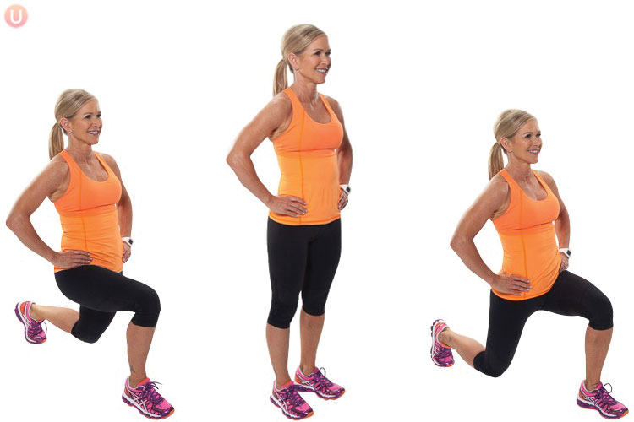
Lunge (30 Sec)

Slide 54
Change to Russian Twist

Slide 55
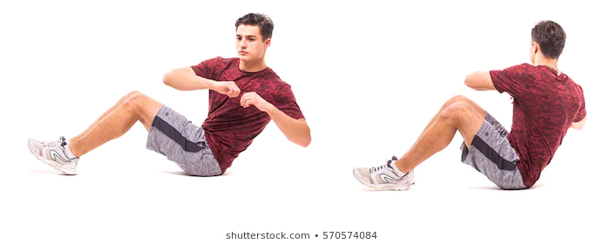
Russian Twist (30 Sec)

Slide 56
Change to Squat Jump

Slide 57
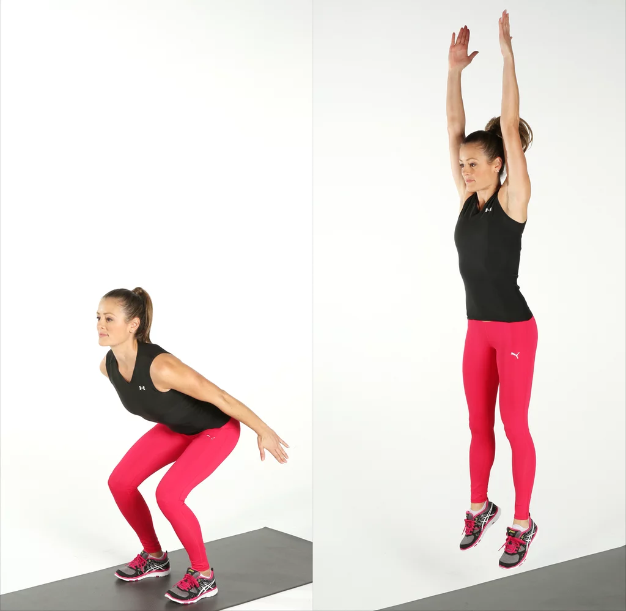
Squat Jump (30 Sec)

Slide 58
Change to Press Up

Slide 59
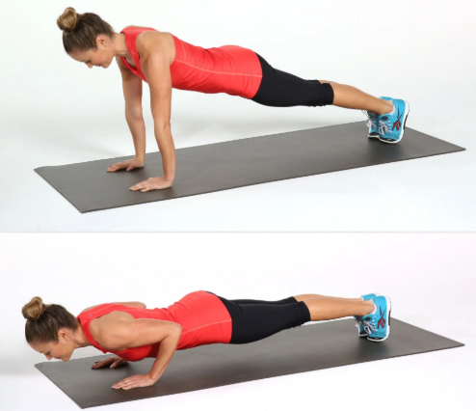
Press Up (30 Sec)

Slide 60
Change to Lunges

Slide 61
Lunge (40 Sec)

Slide 62
Change to Russian Twist

Slide 63
Russian Twist (40 Sec)

Slide 64
Change to Squat Jump

Slide 65
Squat Jump (40 Sec)

Slide 66
Change to Press Up

Slide 67
Press Up (40 Sec)

Slide 68
Change to Lunges

Slide 69
Lunge (50 Sec)

Slide 70
Change to Russian Twist

Slide 71
Russian Twist (50 Sec)

Slide 72
Change to Squat Jump

Slide 73
Squat Jump (50 Sec)

Slide 74
Change to Press Up

Slide 75
Press Up (50 Sec)

Slide 76
Change to Lunges

Slide 77
Lunge (60 Sec)

Slide 78
Change to Russian Twist

Slide 79
Russian Twist (60 Sec)

Slide 80
Change to Squat Jump

Slide 81
Squat Jump (60 Sec)

Slide 82
Change to Press Up

Slide 83
Press Up (60 Sec)

Slide 84
Water Break

Slide 85
Change to Lunges

Slide 86
Lunge (50 Sec)

Slide 87
Change to Russian Twist

Slide 88
Russian Twist (50 Sec)

Slide 89
Change to Squat Jump

Slide 90
Squat Jump (50 Sec)

Slide 91
Change to Press Up

Slide 92
Press Up (50 Sec)

Slide 93
Change to Lunges

Slide 94
Lunge (40 Sec)

Slide 95
Change to Russian Twist

Slide 96
Russian Twist (40 Sec)

Slide 97
Change to Squat Jump

Slide 98
Squat Jump (40 Sec)

Slide 99
Change to Press Up

Slide 100
Press Up (40 Sec)

Slide 101
Cool Down
5 Minutes

